Slide 1
Protection and Communication Abstractions for Web Browsers in MashupOS
Helen J. Wang, Xiaofeng Fan, Jon Howell (MSR)
Collin Jackson (Stanford)
SOSP 2007

Slide 2
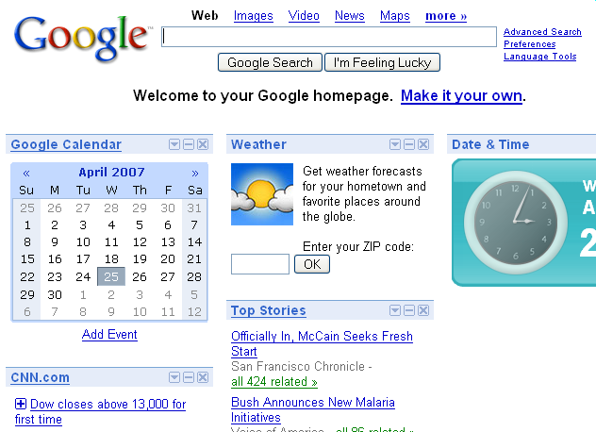

Slide 3
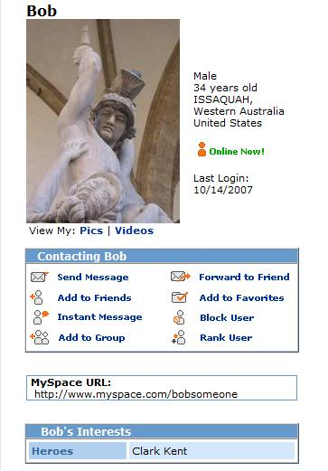
… but most of all, Samy is my hero

Slide 4
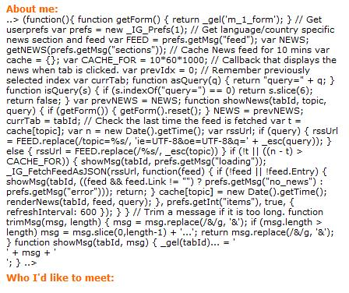

Slide 5
Outline
The problem
The MashupOS project
Protection
Communication
Implementation
Evaluation
Related work
Conclusions

Slide 6
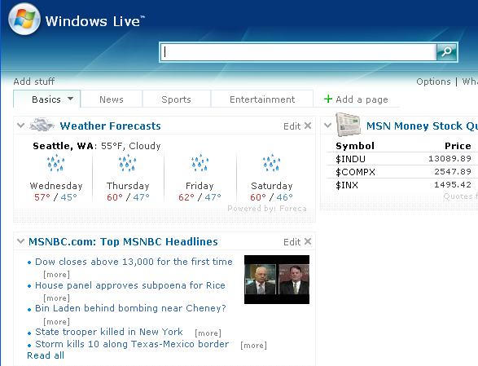
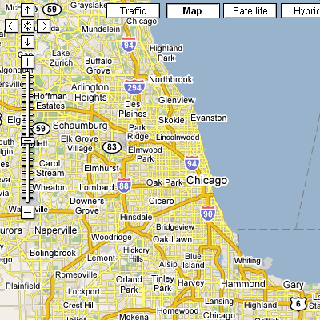
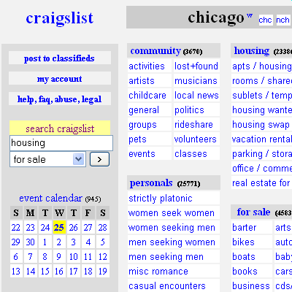
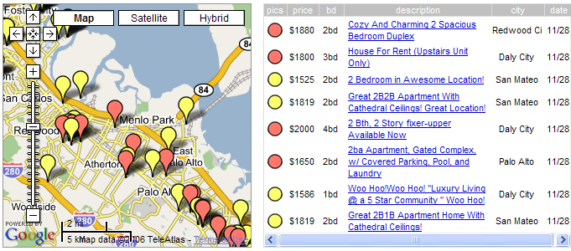
Client Mashups
Web content has evolved from single-principal services to multi-principal services, rivaling that of desktop PCs.
Principal is domain
Notes:
Web content has evolved from single-principal services where a content provider services content from just its own domain to multi-principal services or client mashups where data and code from mutually distrusting domains interact programmatically in a single page at the browser. And they share the underlying resources. The principal here is a domain.
For example, housingmap.com retrieves housing info from craigslist and uses Google’s map script to provide a mapped housing service.
As another example, both Google and Windows Live offer personalized desktop service that gathers many user-selected third-party gadgets into one page
It is exactly this kind of client mashups that have fueled web 2.0, the richness in such services is challenging the desktop PC world.

Slide 7
Browsers Remain
Single-Principal Systems
http://integrator.com/
http://integrator.com/
X
<iframe
src=“http://provider.com/p.html”>
</iframe>
<script
src=“http://provider.com/p.js”>
</script>
The Same Origin Policy (SOP), an all-or-nothing trust model:
  No cross-domain interactions allowed
  (External) scripts run with the privilege of the enclosing page
Notes:
Today’s browsers offer just two ways for cross-domain content to interact:
Either there is no interactions through the frame tags or there is intimate interaction through the script tag.
The other
uses an iframe or a script.
With iframe

Slide 8
Insufficiency of the SOP
Sacrifice security for functionality when including an external script without fully trusting it
E.g., iGoogle, Live gadget aggregators’ inline gadget
Notes:
Inline gadget are third party html and scripts being embedded in the aggregator’s page. So, the third party scripts can access all of the aggregator’s resources.
With iGoogle, if a user includes an inline gadget in their page, Google gives an warning: …
Here, aggregators punt the security question to users, which is undesirable.

Slide 9
Insufficiency of the SOP, Cont.
Cross site scripting (XSS):
  Unchecked user input in a generated page
  E.g., Samy worm: infected 1 million MySpace.com users in 20 hours
Root cause:
  The injected scripts run with the page’s privilege
Samy is my hero
Notes:
Unintentional script inclusion

Slide 10
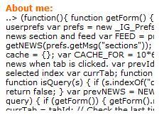
Insufficiency of the SOP, Cont.
Sacrifice functionality for security when denying scripts in third-party content
E.g., MySpace.com disallows scripts in user profiles
Notes:
An integrator may also choose to sacrifice functionality for security, for example, by denying scripts in third party content.
This is the case for MySpace.com. MySpace.com disallows scripts in user profiles as a measure against cross-site scripting attacks. Malicious scripts in a user profile execute on browsers whose users visit the profile. By denying the scripts, MySpace.com hopes to prevent XSS attacks.
But not all scripts are bad, so some nice functionality is sacrificed here. And denying scripts is not easy, the notorious Samy worm still managed to include scripts in user profiles and infected millions of MySpace users in just 20 hours.

Slide 11
The MashupOS Project
Enable browser to be a multi-principal OS
Focus of this paper: protection and communication abstractions
Protection:
  Provide default isolation boundaries
Communications:
  Allow custom and fine-grained access control across isolation boundaries
Notes:
This motivated our MashupOS project at Microsoft Research. In this project, we aim to enable browsers to be a multi-principal OS.
The focus of this paper is on the protection and communication abstractions for the browsers.
Protection is to prevent one principal, or domain in this context, from compromising the confidentiality and integrity of other principals.
Communications allow custom and more fine-grained access control across isolation boundaries

Slide 12
Design Principles
Match all common trust levels to balance ease-of-use and security
  Goal: enable programmers to build robust services
  Non-goal: make it impossible for programmers to shoot themselves in the foot
Easy adoption and no unintended behaviors
Notes:
A key lesson we learned from the Same origin policy is that we must understand all common trust levels between content providers and integrators and we should provide an abstraction for each trust level. Otherwise, integrators would have to make tradeoffs between security and functionality.
Our goal is to …
Also, the new abstractions that we propose should be backward compatible for easy adoption, and the new content that we enable should not have any unintended behavior with existing abstractions.

Slide 13
Outline
The problem
The MashupOS project
Protection
Communication
Implementation
Evaluation
Related work
Conclusions

Slide 14
A Principal’s Resources
Memory:
  heap of script objects including DOM objects that control the display
Persistent state:
  cookies, etc.
Remote data access:
  XMLHttpRequest

Slide 15
Trust Relationship between Providers and Integrators
p.com
i.com
i.com | i.com | Content Semantics | Abstraction | Run-as
HTML
No
No
Isolated
<Frame>
p.com
Internet
XHR
XHR
X
http://i.com/
X
X
<iframe
src=“http://p.com/c.html”>
</iframe>
Notes:
To find missing abstractions in today’s browsers, we construct a table that enumerates all possible trust relationships between an integrator, i.com, and a piece of content provided by a provider, the blue content here.
# When i.com is not trusted to access the blue content
# and the blue content is not trusted to access i.com’s resources,
# the semantics of the blue content is that it is isolated from any integrators. We call such content “isolated content”.
# The abstraction for this trust relationship exists today, they are the <frame> tags for HTML content.
#The isolated content runs as the principle of the provider, p.com, and access all resources belonging to the provider p.com
# and cannot access any of the integrator i.com’s resources

Slide 16
Trust Relationship between Providers and Integrators
p.com
i.com
i.com | i.com | Content Semantics | Abstraction | Run-as
Script
No
No
Isolated
<Frame>
p.com
Internet
Yes
Yes
Open
<Script>
i.com
XHR
http://i.com/
<script
src=“http://p.com/c.js”>
</script>
Notes:
# When i.com is trusted to access the blue content
# and the blue content is trusted to access i.com’s resources,
# the semantics of the blue content is open in that any domain can integrate it.
# The <script> tag realizes this trust relationship today
# The open content runs as the principle of the integrator, i.com, and can access all of i.com’s resources
# when i.com is not trusted to access the blue content, but the blue content can access i.com, this trust relationship does not really make sense; we cannot think of any scenarios that follow this trust relationship
We found no compelling motivation for this trust relationship

Slide 17
Trust Relationship between Providers and Integrators
p.com
i.com
i.com | i.com | Content Semantics | Abstraction | Run-as
No
No
Isolated
<Frame>
p.com
Internet
Yes
Yes
Open
<Script>
i.com
No
Yes
http://i.com/
X
Notes:
# When i.com is trusted to access the blue content
# and the blue content is trusted to access i.com’s resources,
# the semantics of the blue content is open in that any domain can integrate it.
# The <script> tag realizes this trust relationship today
# The open content runs as the principle of the integrator, i.com, and can access all of i.com’s resources
# when i.com is not trusted to access the blue content, but the blue content can access i.com, this trust relationship does not really make sense; we cannot think of any scenarios that follow this trust relationship
We found no compelling motivation for this trust relationship

Slide 18
Trust Relationship between Providers and Integrators
p.com
i.com
i.com | i.com | Content Semantics | Abstraction | Run-as
Unauth
No
No
Isolated
<Frame>
p.com
Internet
XHR
XHR
Yes
Yes
Open
<Script>
i.com
X
X
No
Yes
http://i.com/
Yes
No
Unauthorized
<Sandbox>
<OpenSandbox>
None
X
<sandbox
src=“http://p.com/c.html”>
</sandbox>
Unauthorized content is not authorized to access
any principal’s resources.
Notes:
# The last row of the table is when i.com is trusted to access the blue content
# and the blue content is not trusted to access i.com’s resources.
# For example, i.com may want to use an external script and yet does not want the script to access i.com’s resources
# For this scenario, the content should not run as the provider since the integrator can manipulate the content, and the content should not run as the integrator, either, since the integrator does not grant any resource access to it.
# No protection abstraction is available today for this trust relationship.
# here, we introduce “unauthorized” content and the corresponding sandbox abstractions for browsers to render such content
** clealry don’t run as integrator. However, even if provider provided the content, we don’t want this content to run as the provider since the integrator could tamper the content

Slide 19
Properties of Sandbox
Asymmetric access
  Access: reading/writing script global objects, function invocations, modifying/creating DOM elements inside the sandbox
Invoking a sandbox’s function is done in the context of the sandbox
  setuid (“unauthorized”) before invocation and setuid (“enclosingPagePrincipal) upon exit
The enclosing page cannot pass non-sandbox object references into the sandbox.
  Programmers can put needed references inside the sandbox
Open vs. Private sandbox
  See the paper

Slide 20
Sandbox for Safe Mashups with Ease
http://Mashup.com/index.htm
<script>
// local script to Mashup.com
// calling functions in a.js and b.js
</script>
X
<script src=“a.com/a.js”> </script>
<div id=“displayAreaForA”> … </div>
X
<script src=“b.com/b.js”> </script>
Notes:
A picture is good here
Definitely talk about the div

Slide 21
Hosting Third-Party Content as Unauthorized Content
Combats cross site scripting attacks in a fundamental way
  Put user input into a sandbox
  Does not have to sacrifice functionality
Helps with Web spam
  Discount the score of hyperlinks in third party content

Slide 22
Provider-Browser Protocol for Unauthorized Content
Unauthorized content must be sandboxed and must not be renderable by frames
  Otherwise, unauthorized content would run as the principal of the frame
Employ the MIME protocol:
  Require providers to prefix unauthorized content subtype with x-privateUnauthorized+ or x-openUnauthorized+
  E.g., text/html → text/x-privateUnauthorized+html
  Verified that IE and Firefox cannot render these content types with <frame> and <script>
Prevent providers from unintentionally publishing unauthorized content as other types of content:
  Constrain sandbox to take only unauthorized content
Notes:
Achieving the goal of no unintended behavior

Slide 23
Outline
The problem
The MashupOS project
Protection
Communication
Implementation
Evaluation
Related work
Conclusions

Slide 24
Communications
Message passing across the isolation boundaries enable custom, fine-grained access control
a.com
b.com
CommRequest
CommRequest
Unauthorized
Isolated
Isolated
Notes:
For custom, fine-grained access control, we propose a CommRequest communication abstraction for message passing across isolation boundary. Our proposal unifies existing proposals on browser-side communications as well as browser-to-server communications.
3
Server may be in browser
Cross domain allowed
Server is told the source domain

Slide 25
Implementation
MashupOS
Script Engine
Proxy
HTML Layout Engine
Script execution
DOM object access
Script
Engine
DOM object update
MashupOS
transformed HTML
Original
HTML
MashupOS
MIME
Filter
Use cross-domain frames as our building blocks, but we apply our access control
Notes:
Realized almost all proposed abstractions and their properties except the feature of decoupling display from ServiceInstance
Requires one Friv per ServiceInstances.

Slide 26
Evaluation:
Showcase Application
PhotoLoc, a photo location service
  Mash up Google’s map service and Flickr’s geo-tagged photo gallery service
  Map out the locations of photographs taken
Trust relationship with Flickr: mutually distrusting
Trust relationship with Google map library: Photoloc.com does not want Google’s map library to access all its resources
Notes:
Show picture

Slide 27
PhotoLoc/index.htm
<script>
  function setPhotoLoc(request) {
  var coordinate = request.body;
  var latitude = getLatitude (coordinate);
  var longitude = getLongitude (coordinate);
  G.map.setCenter(new GLatLng(latitude, longitude), 6);
  }
  var svr = new CommServer();
  svr.listenTo(“recvLocationPort”, setPhotoLoc);
</script>
<Friv src=”http://ourFlicker/newGeoTaggedPhoto/” id=F>
</Friv>
<Sandbox src=”g.uhtml” id=G> </Sandbox>
Direct
access
CommRequest

Slide 28
Evaluation:
Prototype Performance
Microbenchmarking for script engine proxy
  Negligible overhead for no or moderate DOM manipulations
  33%--82% overhead with heavy DOM manipulations
Macrobenchmark measures overall page-loading time using top 500 pages from the top click-through search results of MSN search from 2005
  shows no impact
Anticipate in-browser implementation to have low overhead

Slide 29
Related work
Crockford’s <Module>
  Symmetric isolation with socket-like communication with the enclosing page
Wahbe et al’s Software Fault Isolation
  Asymmetric access though never leveraged
  Primary goal was to avoid context switches for untrusted code in a process
Cox et al’s Tahoma browser operating system uses VM to
  Protect the host system from browser and web services
  Protect web applications (a set of web sites) from one another

Slide 30
Conclusions
Web content involves multiple principals
Browsers remain a single principal platform
The missing protection abstraction: Unauthorized content and <sandbox>
  Enable safe mashups with ease
  Combats cross-site scripting in a fundamental way
CommRequest allows fine-grained access control across isolation boundaries
Practical for deployment

Slide 31


Slide 32



Slide 33
Acknowledgement
Andy Begel, Shuo Chen, Adam Costello, Douglas Crockford, Richard Draves, John Dunagan, Sunava Dutta, Hank Levy, Charlie Kaufman, Jay Lorch, Charlie Reis, Yinglian Xie, Zhenbin Xu, and anonymous reviewers

Slide 34
Thank you!

Slide 35
CommRequest vs. XMLHttpRequest
Cross domain
Source labeled
No cookies sent
“Server” can be on client
Reply from remote server tagged with special MIME type
Syntax similar to socket API and XHR
Notes:
So that content from legacy servers will be discarded

Slide 36
CommRequest
Server:
      server = new CommServer();
      server.listenTo(“aPort”, requestHandlerFunction);
Client:
      req = new CommRequest();
      req.open (“INVOKE”, “local:http://bob.com//aPort”, isSynchronous);
      req.send (requestData);
      req.onreadystatechange = function () { …}
Notes:
Key properties:
Browsers label the originating domain of the request
No implicit information (such as cookie) sent
For browser-server communication, HTTP content-type must be “application/CommRequest” to avoid interaction with legacy servers

Slide 37
ourFlicker.com/newGeoTaggedPhoto/ index.htm
<body onload=”sendLoc”>
<script>
  function sendLoc() {
  if ( hasCoordinate ) {
  var req = new CommRequest();
  req.open("INVOKE", "local:parent//recvLocationPort");
  var requestBody = createCoordinate (latitude, longitude);
  req.send(requestBody);
  }
  }
</script>
…
</body>

Slide 38
PhotoLoc.com/g.uhtml
<html> <body onload=”createGmapWithDiv”>
<script src=”http://maps.google.com/?file=api& ...”></script>
<script>
  var map;
  function createGmapWithDiv() {
  map = new GMap2(divMap);
  }
</script>
<div id=”divMap” style=”width:500px; height=360px”>
</div>
…
</body> </html>

Slide 39
Future Work
Robust implementation of the protection model
Tools to detect whether a browser extension violates the browser’s protection model
Tools for ensuring proper segregation of different content types
Resource management, OS facilities

