Slide 1
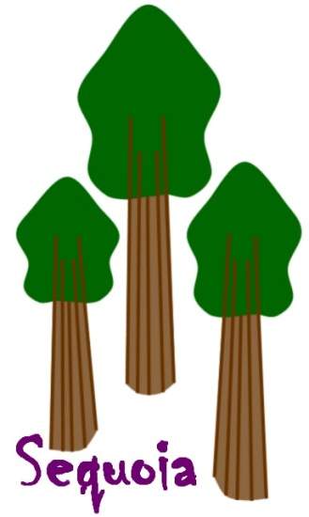
Sequoia: Virtual-Tree Models for Internet Path Metrics
Rama
Microsoft Research
Also: Ittai Abraham (Hebrew Univ.)
Mahesh Balakrishnan (Cornell)
Archit Gupta (Univ. Wisc.)
Fabian Kuhn (EPFL)
Dahlia Malkhi (MSR)
Kunal Talwar (MSR)

Slide 2
Introduction
Goal: Model properties (latency, bandwidth) of paths between Internet end hosts
Notes:
Without actively measuring all-pair metrics, we fit nodes into a model that estimates all-pair metrics.

Slide 3
Applications
“what’s the server with the largest bandwidth that the client can download content from?”
  Content distribution
“what’s the relay node that gives the shortest delay VoIP connection between two users?”
  VoIP routing
“what’s the best server to coordinate the online game between a set of players?”
  Online gaming
Notes:
Without actively measuring all-pair metrics, we fit nodes into a model that estimates all-pair metrics.

Slide 4
Sequoia Virtual Trees
Network embedding into trees
  Leaf nodes (A, B, C, R) are end hosts

Slide 5
Sequoia Virtual Trees
Network embedding into trees
  Leaf nodes (A, B, C, R) are end hosts
  Inner nodes (s, t) are “virtual”

Slide 6
Sequoia Virtual Trees
Network embedding into trees
  Leaf nodes (A, B, C, R) are end hosts
  Inner nodes (s, t) are “virtual”
  Edge weights model path property

Slide 7
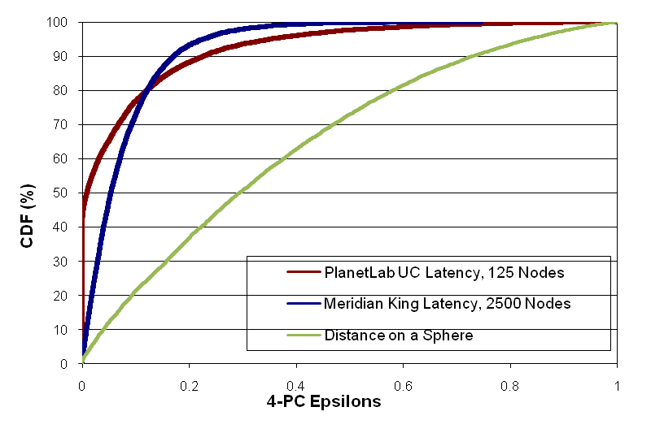
“Treeness” of the Internet

Slide 8
Accuracy of Virtual-Tree Models
Relative Error
 | PlanetLab Latency 125 nodes | King Latency 2500 nodes
Median | 14 % | 20 %
75th p.c. | 22 % | 35 %
90th p.c. | 50 % | 56 %
PlanetLab Bandwidth 390 nodes
24 %
41 %
65 %

Slide 9
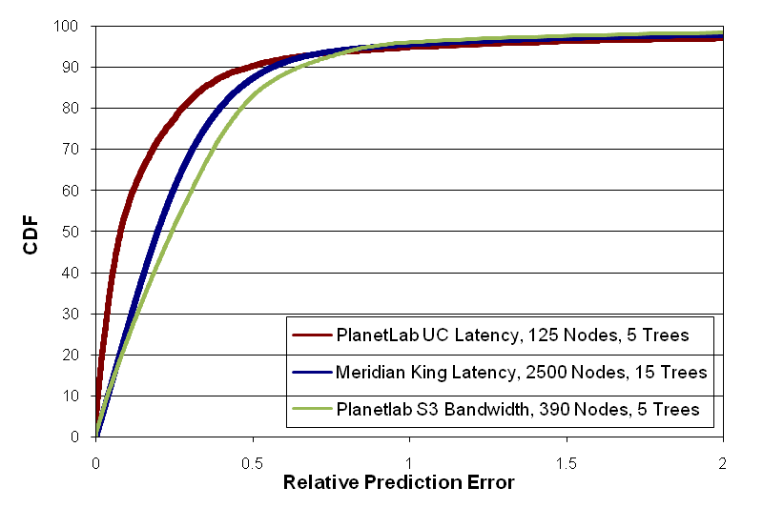
Accuracy of Virtual-Tree Models

Slide 10
Distance Labels a.k.a ‘‘Coordinates’’
Distance Label = Path to the Root
  Example: A: (s,t,R) and C: (t,R)
Trivial to estimate quality of paths
  Latency: d(A,C) = d(A,s) + d(s,t) + d(t,C)
As convenient as coordinate-based systems

Slide 11
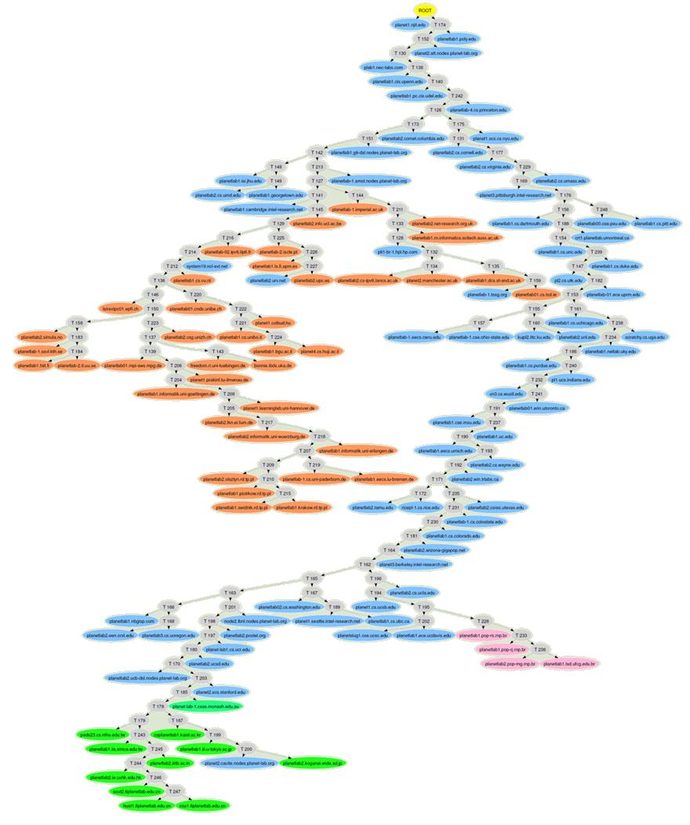
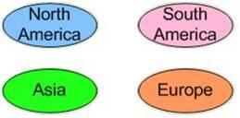
Sequoia Tree for PlanetLab Latencies

Slide 12
Hierarchical Clustering for
PlanetLab Nodes in Europe

Slide 13
Summary
Virtual Trees to Model Internet Path Metrics
Predict Bandwidth and Latency
Convenient ‘‘Coordinates’’
Hierarchical Clustering
http://research.microsoft.com/research/sv/sequoia

Slide 14
Sequoia Virtual Trees contd.
Path property prediction
  Trivial to estimate quality of paths
  Latency: d(A,C) = d(A,s) + d(s,t) + d(t,C)
Server selection
  Constraint-Satisfaction queries
  Tree traversal and pruning
Hierarchical clustering
  Inherent hierarchy
  “Virtual” nodes separate clusters

Slide 15
Why Trees?
Intuitive model compared to embedding in coordinate spaces (GNP, Vivaldi, PIC)
  As convenient to represent as coordinates
    Path to root acts as distance labels
  Well-understood and widely-used in distributed systems
Added Functionalities
  Facilitates efficient server selection
Inherent Hierarchy
  Useful for systems that rely on hierarchy (application-level multicast, network monitoring and aggregation, etc.)

Slide 16
Is the Internet a Tree?
The 4-Points Condition:
ε-4-Points Condition:
  d(s,v)+d(u,t) = d(s,t)+d(u,v) + 2 ε min{d(s,v),d(t,u)}
v
u
v
u
v
u
s
t
s
t
s
t
d(s,u)+d(t,v)
=
d(s,t)+d(u,v)
≤
d(s,u)+d(t,v)
distance metric is tree metric ↔ 4PC is satisfied for every 4 points
Notes:
Well, it’s of course clear that the Internet is not a tree and It’s not at all clear whether the Internet can even be approximately represented by a tree.
To get a notion of how close something is to a tree, let’s look at an important property of trees. Consider four points s. t, u, and v on a tree. Up to permutation of the nodes there is only one way how the topology of a tree of four nodes can look like. Let’s now look at the three ways in which we can partition the four points into two pairs and let’s look at the distances between the nodes in these pairs. If we add the two green diagonal distances and if we add the two red horizontal distances, it add up the same path segments in both cases and therefore get the same sum. Clearly the last blue pair of distances is smaller.
So, if we look at any four points on a tree and if we look at the three sum of distances coming from the three ways of partitioning the four nodes into two pairs, the largest two sums are equal. This condition is called the 4-point condition. It actually turns out that whenever a metric space satisfies the 4PC for every 4 points, the metric can be represented by a tree. Or in other words a metric can be isometrically embedded into a tree whenever every set of four points can be isometrically embedded into a tree.

Slide 17
Sequoia Tree: Construction
Root serves as a reference node
  All distances to the root are accurate
Each node has an anchor node
  Distance to the anchor is also accurate
  Unless there is a violation of triangle <>
Other distances may not be exact
Multiple trees improve accuracy

Slide 18
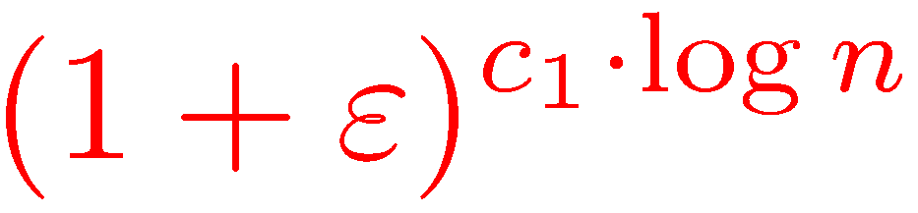
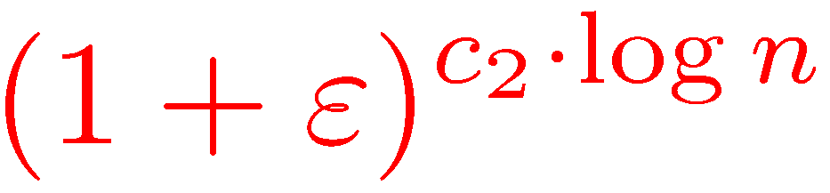
Sequoia Tree: Construction
Upper Bound:
  Algorithm which computes tree with distortion
Lower Bound:
  Metric satisfying ε-4PC which requires distortion
[ABKMRT] PODC 07

Slide 19
Applications
Network-Aware Overlays
  Peer/neighbor selection (DHTs, Torrents, etc.)
Server Selection
  Simple (CDNs)
    closest-node, best-provisioned-node discovery
  Complex (VoIP, Online Games)
    Relays and Coordination servers
Hierarchical clustering
  multicast, online-streaming, network aggregation

Slide 20
Current Work
Evaluation
  Tree-building algorithms
  Efficient anchor selection
Applications
  Peer-to-peer systems (neighbor-selection)
  Content distribution networks (closest-node, best-provisioned-node discovery)
  Relays and Coordination servers (VoIP, Online Games)
  Hierarchical clustering (multicast, online-streaming, network aggregation)
System Building
  Fully Decentralized vs. partially decentralized vs. centralized

Slide 21
Your Involvement!
Collaborations are welcome!
Datasets for bandwidth, loss rate, etc.
  Pointers to existing datasets
  Joint collaboration for collecting new datasets
Applications
  Killer App?
  Product groups that might be interested in Sequoia
  Any other suggestions for applications
Email: rama@microsoft.com or dalia@microsoft.com
http://research.microsoft.com/research/sv/sequoia

