Slide 1



Real Life is Uncertain. Consensus Should Be Too!
Reginald Frank, Octavio Lomeli, Neil Giridharan,
Soujanya Ponnapalli, Marcos K. Aguilera, Natacha Crooks

Slide 2
Real Life is Uncertain. Consensus Should Be Too!
Reginald Frank, Octavio Lomeli, Neil Giridharan,
Soujanya Ponnapalli, Marcos K. Aguilera, Natacha Crooks
Notes:
Hello, I’m Reginald Frank.
And Ideally, I would be presenting this talk with my collaborator Soujanya Ponnapalli (po-nuh-pal-li), but the visa processing delays hit her too :((
So instead she is working diligently in Berkeley while I’m unexpectedly giving both parts of the talk.
But lets get started.
Today I want to convince you that Consensus <pause> must take inspiration from Real Life!

Slide 3



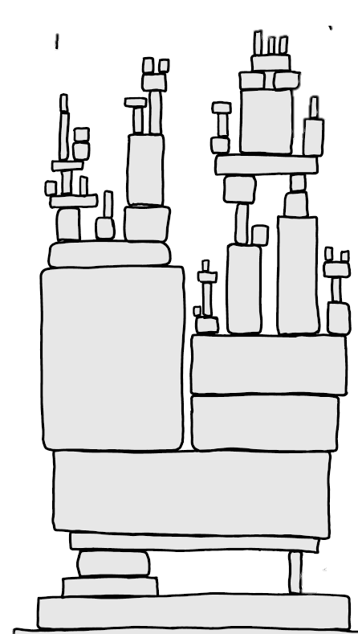



Consensus and Distributed Systems
Distributed Systems
Consensus
The state of
distributed systems
Notes:
Fundamentally, All Distributed Systems need to handle machine failures, and they do this by using consensus as a trusted, failure-handling core which they can place their application logic on top of
For example, cluster management services like Kubernetes, databases like CockroachDB, and even machine learning infrastructure like huggingface all depend on consensus to function properly
But before I go on, <pause...> let me tell you a little bit about car insurance.

Slide 4



Car Insurance Policies
Notes:
Wait don’t go! I’m not here to sell you car insurance, I actually hit my quota earlier this week.
So! Insurance policies follow a simple formula.
First, you need to consider what problems you might face in the real world
Then based on that you’ll have to pay some cost
But, as a result, you _will_ have protection for your view of the world.
For example,

Slide 5







Car Insurance Policies
Notes:
If you just bought a car, you might think the world is all sunshine and rainbows
And for this world view, you could get extremely affordable insurance
While still having protection.
However, this insurance will only protect us against sunshine and rainbows, so if someone breaks into my car I won’t have protection against this because this scenario did not fit into my world view

Slide 6





Car Insurance Policies
Notes:
In contrast
If you’ve had bad experiences with car failures, you might think even meteors could be on the horizon!!
Getting coverage against this is going to be extremely expensive, BUT ! In this horrible reality, you, you still will be covered ☺
Now that same break-in from before is no issue, because that situation does fit into your world view.
<pause>
Now, why have I been talking to you about insurance?

Slide 7



Consensus is an Insurance Policy
Fault Model
Performance
and Cost
Guarantees
Notes:
Its because consensus [BREATHE] __IS__ an insurance policy. [1… 2…. 3… ]
Our world view maps to a fault model
Our budget is the desired performance and dollar cost
and our Guarantees are the traditional safety and liveness you have come to know and love, or hate <shrug>
So,

Slide 8



Consensus is an Insurance Policy
Fault Model
Performance
and Cost
Guarantees
$f=0$
Notes:
So, if all your machines are new and you would like to assume that you will not face any machine failures
then you’ll have amazing performance for cheap
and your systems will also work well...
BUT, a single machine failure WILL break our consensus guarantees, causing a deployment disaster

Slide 9




Consensus is an Insurance Policy
Fault Model
Performance
and Cost
Guarantees
$f=0$
$f$
Notes:
On the other hand,
If you assume tens of machines may fail at any time,
then you’d need a lot of money to run consensus on that huge cluster
But now your systems will be protected against multiple machine faults.
So, a single server failure was will not cause any issues because this situation fits into your world view.

Slide 10

Consensus is an Insurance Policy
Fault Model
Performance
and Cost
Guarantees
$f=0$
$f$
You buy protection for your world view!
Notes:
The point that I really want to get across is that in consensus -- You are buying protection for your view of the world!!!
>> continue naturally !

Slide 11


Fault Models Must Match Reality
Optimistic
Reality
Pessimistic
$f=0$
$f$
Notes:
That means!!! your world view -- better -- match reality. <MORE DRAMAAAA>
If in reality only one machine will fail
But my model is too optimistic -- and thinks no machines will fail, then my system is quite likely to break
On the other hand, if my fault model is too pessimistic thinking tens of machines will fail -- then my system will work, but my boss is going to be awfully unhappy with how much money I'm costing them
[Pause LONGGGGGG]

Slide 12
Current fault models do not accurately capture reality
Protocols overpay for protection or do not fully protect against failures!
Notes:
And the real problem with consensus [breath] is that current consensus fault models, [pause] no matter how you configure them, [pause] do not and can not accurately capture reality.
And as a consequence, consensus protocols either overpay for protecting systems or do not fully protect them against failures!
To explain this, lets zoom into consensus' formal model (maybe different wording for "formal model")

Slide 13

Consensus in the Real World
Application
Guarantees
Operations…
Safety: Operations commit in the same global order
Consensus Protocol
Liveness: Every operation eventually commits
Log of operations
…
Notes:
Applications interact with consensus protocols by sending the protocol a series of operations
The consensus protocol will then coordinate a group of machines to order and persist the operations into a log
In order for this log to be useful, consensus provides two guarantees.
First – every machine in the protocol must agree on the order of operations in the log. This property is called Safety.
Second, every operation given to consensus will eventually appear in the log. This property is called liveness
With these two properties, we can use consensus to build complex applications

Slide 14


Consensus in the Real World
Application
Fault Model
Write(key, value)
Key-Value Store (Etcd)
Raft
$$f=1$$
Read/Write Operation Log
…
Notes:
To make this really concrete, if an application wanted a key value store, it might use etcd.
Applications would submit their read/write requests to Etcd -- which internally uses Raft, a consensus protocol, to order each read/write request into a log
Etcd can then replay the ordered log of operations to respond to any request that applications give it even if failures occur.
In general, protocols like raft use the letter f to denote the maximum number of faults which can occur in a deployment. And this parameter f totally defines the world view of consensus.

Slide 15
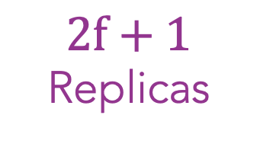
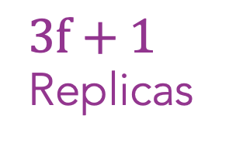

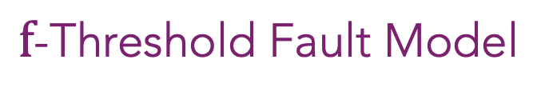
Consensus in the Real World
$f$-Threshold Fault Model
Consensus Guarantees
when #faults$≤f$
Crash and Byzantine
Faults
Crash
Faults
Byzantine
Faults
$2f+1$ Replicas
$3f+1$ Replicas
Upright Replication
Notes:
As a result, we say these systems use an f-threshold fault model
Meaning they only provide their guarantees when the real number of faults in a system is <= f
Even in this f threshold model, there are many variations on what a fault means.
For example, Crash Fault Tolerance uses a network of 2f+1 nodes to withstand f __crash__ faults where faulty machines stop working
Byzantine Fault tolerance can handle f __byzantine__ faults where faulty machines may deviate from the protocol
And there are models like upright which mix the two to handle some number of crash and byzantine faults

Slide 16



Key Observations
The f-threshold fault model fails to captures reality
In practice, machine failures are probabilistic
Protocols cannot provide better than probabilistic guarantees
Notes:
In our work studying f-threshold fault models, we make three key observations!
Current <> f-threshold fault models poorly align with reality
Because fundamentally, everyone (sheepishly: except consensus researchers ofc!) <> think about failures in terms of probabilities
And when faults are probabilistic… protocols can provide NO better than <> probabilistic guarantees!
Let’s take a closer look at each of them!

Slide 17





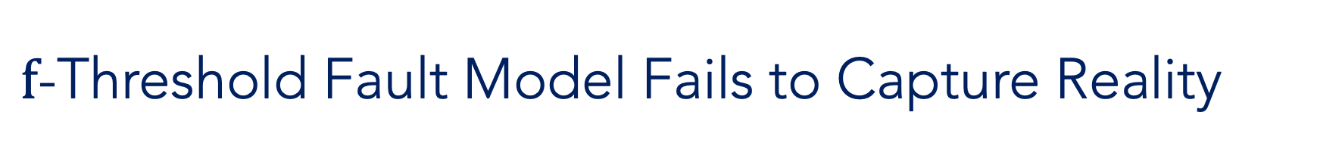
$f$-Threshold Fault Model Fails to Capture Reality
Nodes are either correct or faulty
All nodes can fail
Faults are uniform
Some nodes are more likely to fail
…
…
…
Notes:
As we mentioned earlier,
a fault model defines the assumed world view of the consensus protocol.
Today, developers make assumptions about the network, the type of faults, and the number of faults.
In effect, <> protocols are designed to view nodes as either correct or faulty
And they protect against failures as if they are uniformly distributed amongst all nodes!
But…, in practice… all nodes can fail <> and some nodes <> are more likely to fail than others.

Slide 18
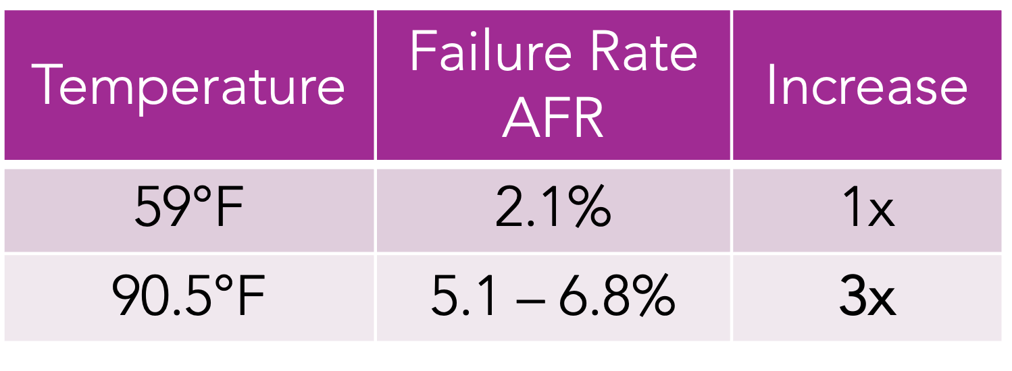
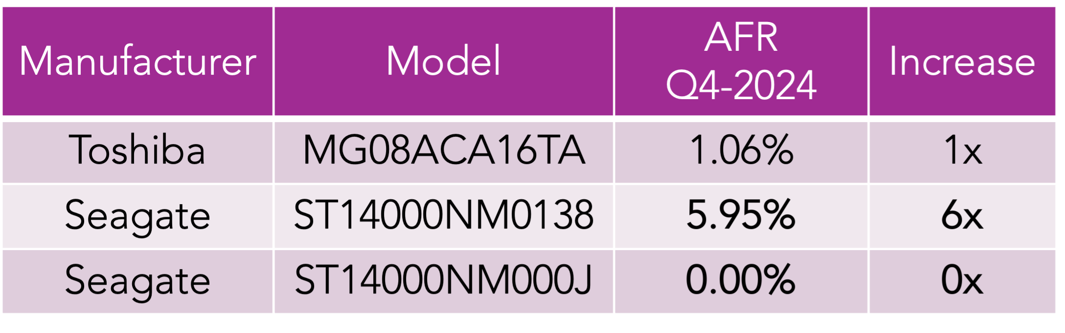
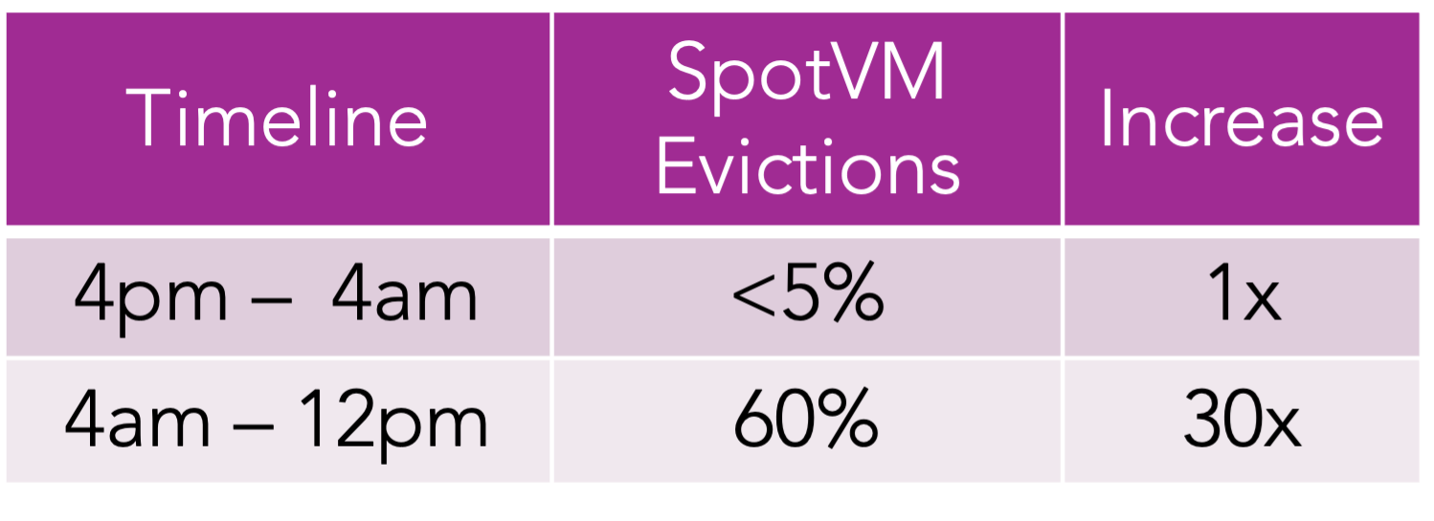
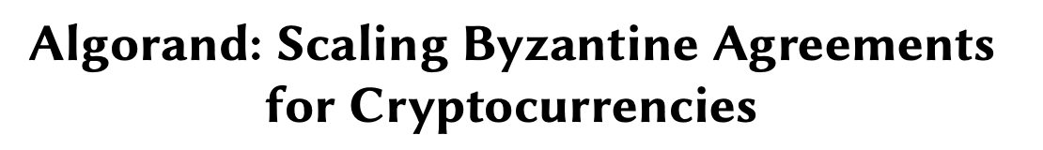
(a) Fault rates are not uniform
Temperature | Failure Rate AFR | Increase
59°F | 2.1% | 1x
90.5°F | 5.1 – 6.8% | 3x
Manufacturer | Model | AFR Q4-2024 | Increase
Toshiba | MG08ACA16TA | 1.06% | 1x
Seagate | ST14000NM0138 | 5.95% | 6x
Seagate | ST14000NM000J | 0.00% | 0x
Timeline | SpotVM Evictions | Increase
4pm – 4am | <5% | 1x
4am – 12pm | 60% | 30x
[1] https://blocksandfiles.com/2024/05/02/disk-failure-rates-in-data-centres-are-falling-says-backblaze/
[2] https://www.backblaze.com/blog/backblaze-drive-stats-for-2024/
[3] Memory-Harvesting VMs in Cloud Platforms, ASPLOS’22
[4] Snape: Reliable and Low-Cost Computing with Mixture of Spot and On-Demand VMs, ASPLOS’23
Notes:
This is because faults are not uniform… and they are RARELY homogenous!
For example, machines that are improperly cooled experience higher fault rates.
Here, an AFR or annual fault rate of 2.1%, means that 21 of your 1000 disks will fail over the course of one year! At higher temperatures, __68__ out of 1000 disks could fail in a year.
faults also often depend on both the exact hardware model and manufacturer.
Now if we consider the cloud with different compute offerings, a spotVM is far more likely to fail than a standard VM!
In some systems, these non-uniform failure rates capture more complex, trust dynamics.
In stake-based blockchains, for example, all parties need not be trusted uniformly: If I have a higher stake, I have more to lose if the system fails, I’d be a better bet to avoid failures!

Slide 19
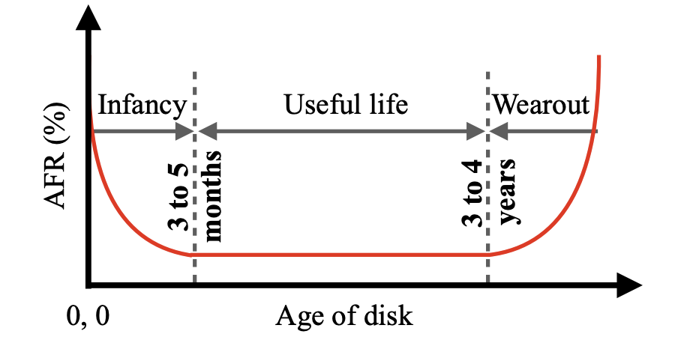


(b) Fault rates evolve over time
VMs | Evictions 10 mins | Evictions 1 day
SpotVMs | 10% | 55.3%
[1] Cluster storage systems gotta have HeART: improving storage efficiency by exploiting disk-reliability heterogeneity
[2] https://www.backblaze.com/blog/drive-failure-over-time-the-bathtub-curve-is-leaking/
[3] Snape: Reliable and Low-Cost Computing with Mixture of Spot and On-Demand VMs, ASPLOS’23
Notes:
In practice, fault rates are almost always changing with time! <slow>
The fault rate increases with a machine’s age, usage, and load on the system!
For example, <> disks follow a bath-tub curve: they have three unique phases:
a high infant mortality rate, a stable useful life, and a wear-out phase –with a high fault rate. This is trend holds for most hardware.
If we look at SpotVMs, their eviction rate also changes throughout their lifespan!
In systems with complex-trust dynamics, the changing geo-political scenario could also change how trustworthy different parties are!
for example, the Canadian gov decided to not trust soujanya :sob:!
----
55.31% of the evicted spot VMs and 32.80% of the deleted spot VMs live longer than one hour.

Slide 20


(c) Faults may be correlated
https://blogs.microsoft.com/blog/2024/07/20/helping-our-customers-through-the-crowdstrike-outage/
https://www.techtarget.com/whatis/feature/Explaining-the-largest-IT-outage-in-history-and-whats-next
Notes:
Even worse, Machine faults can be correlated! (this is a reaaaal pain!!!)
Often, they are not exactly bound by “f” either!
Consider the recent crowdstrike outage at Microsoft.
New software updates caused a widespread downtime of multiple servers at Microsoft
leading to up to 5.4 Billion dollars in lost revenue!
-------------------
a faulty software update from the cybersecurity firm CrowdStrike. This update, intended for Falcon Sensor security software, caused widespread crashes and unresponsiveness
$5.4 billion

Slide 21
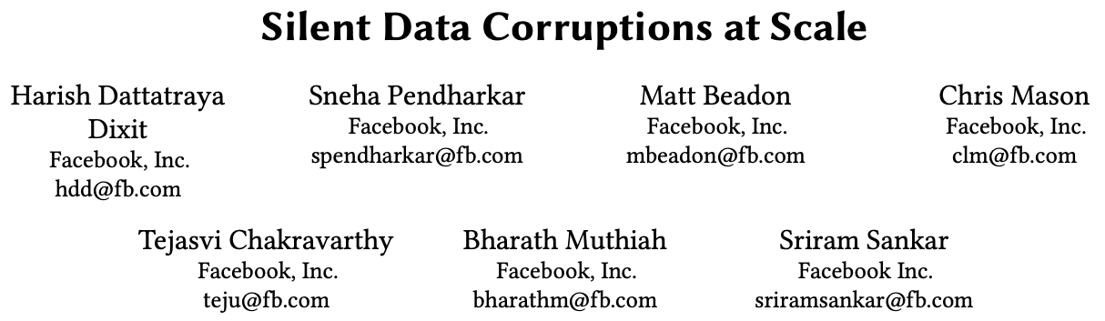
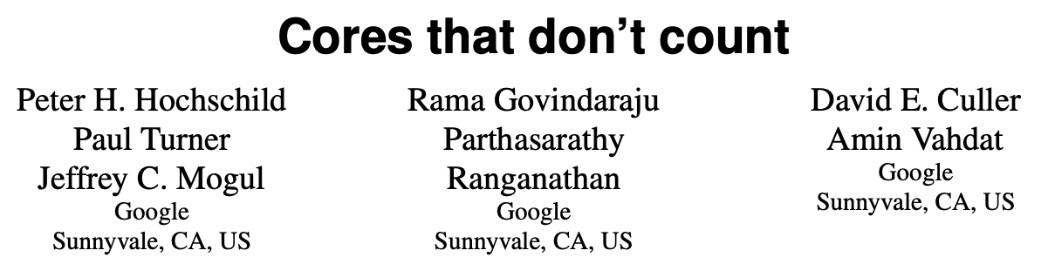
(d) Faults are complex
[1] Cluster storage systems gotta have HeART: improving storage efficiency by exploiting disk-reliability heterogeneity
[2] https://www.backblaze.com/blog/drive-failure-over-time-the-bathtub-curve-is-leaking/
Notes:
Faults are also complex!
Recent works highlight that silent compute errors and data corruptions
Are a phenomenon which can occur scale!

Slide 22

$f$-Threshold Fault Model Fails to Capture Reality
(a) Fault rates are not uniform
(b) Fault rates evolve over time
(c) Faults may be correlated
(d) Faults are complex
In practice, machine faults are probabilistic
Notes:
Overall, the point I want to emphasize is that,
In practice, faults ARE probabilistic and
In other domains, we have already been reasoning about machine faults using probability curves.
<pause>
So we ask - <look around> - why should consensus be any different?

Slide 23
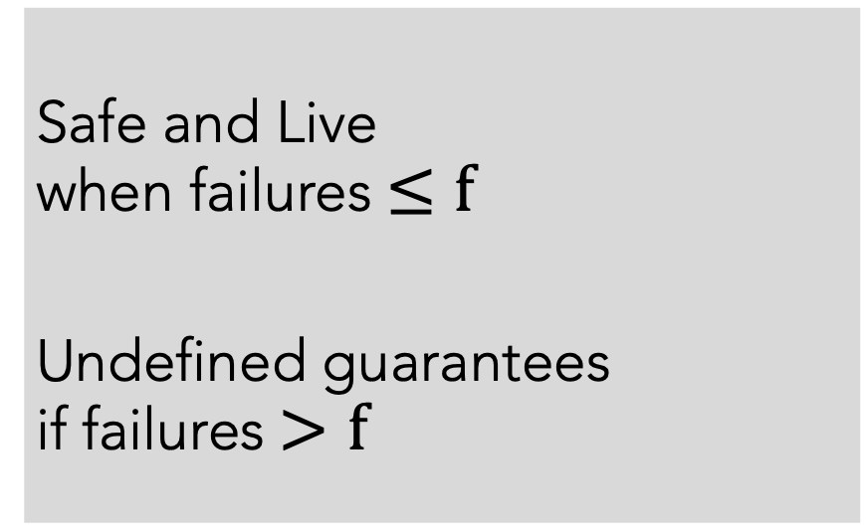
Consensus Guarantees are Mismatched
All-or-nothing guarantees
Safe and Live
when failures$≤f$
Undefined guarantees
if failures$>f$
Notes:
If we take a step back… and look at the guarantees of consensus protocols TODAY <>
They provide all... or nothing... guarantees.
Systems are guaranteed to be safe and live with less than f node failures
And provide no guarantees whatsoever... if the number of failures exceed f.

Slide 24
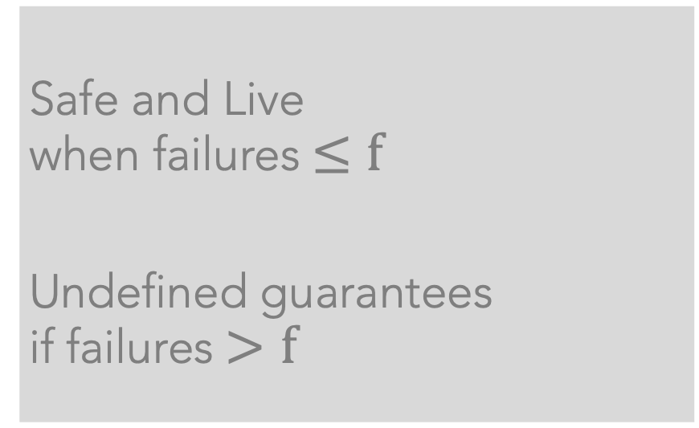
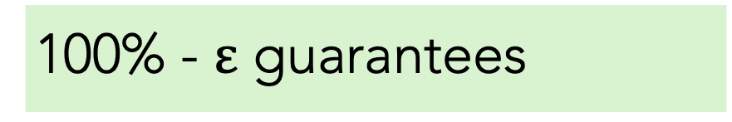
Consensus Guarantees are Mismatched
All-or-nothing guarantees
100% - $ε$ guarantees
Safe and Live
when failures$≤f$
Undefined guarantees
if failures$>f$
Safe: Every node has a non-zero failure probability and eventually all nodes will fail
No protocol can do better than probabilistic guarantees
Notes:
But, in practice,
it is always possible for failures to exceed f!
<> So no consensus protocol can provide a guarantee stronger than probabilistic safety and liveness.
<>Every node has a non-zero probability of failure and eventually every node WILL fail.
<>So, no system can make 100% guarantees!
-------
[For longer talks, add slide to describe mismatched guarantees]
More fundamentally, safety and liveness properties do not match with how applications think about guarantees!
For example, a system that is Live could also be 0% available… making it unusable for the application.
So, ideally, we want probabilistic guarantees that are a better match with application demands!

Slide 25
Consensus Guarantees are Mismatched
All-or-nothing guarantees
100% - $ε$ guarantees
Safe and Live
when failures$≤f$
Undefined guarantees
if failures$>f$
Raft is only 99.97% [safe&live] in three-node deployments if nodes suffer a 1% fault rate!
Notes:
We’ll spare you the math details here…
But on real hardware… consensus is already probabilistic, like it or not! <pause>
In our paper we conducted a probabilistic analysis and found that in a three node deployment where each node suffers a 1% fault rate, Raft, a popular crash-fault tolerant protocol, is only 3-nines [safe and live]

Slide 26
Consensus Guarantees are Mismatched
AWS | Standard S3 | S3 Intelligent Tiering | S3 Express One Zone
Designed for availability | 99.99% | 99.9% | 99.95%
Availability SLA | 99.9% | 99% | 99.9%
S3 is designed to exceed 11 nines of data durability
Google Spanner is designed to support 5 nines of availability
[1] https://aws.amazon.com/s3/storage-classes/
[2] https://www.frictionlesspost.com/p/google-spanner-serves-trillions-of-rows-with-99-999-reliability
Notes:
Storage systems recognize this reality already.
S3, for instance, describes its guarantees to exceed 11 9s of durability
And they customize their availability to exceed applications’ availability SLA or service level agreement
So again we ask– why should consensus be any different?

Slide 27
Our Vision: Probabilistic Consensus for the Real World!
Probabilistic fault models
that accurately capture reality
Notes:
Our vision,
is probabilistic consensus for the real world!
We want to utilize existing knowledge of machine faults to design probabilistic fault models that accurately capture reality

Slide 28
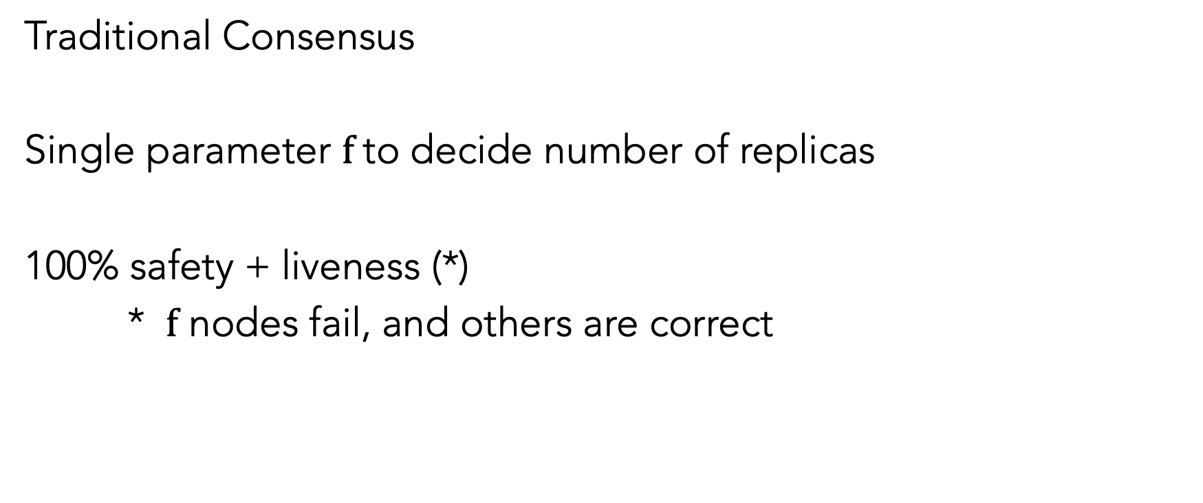
Simple Abstractions: Key Challenge
Traditional Consensus
Single parameter $f$to decide number of replicas
100% safety + liveness (*)
* $f$ nodes fail, and others are correct
Notes:
The main challenge to realize our vision,
is to avoid making consensus protocols more complex or less useful as a consequence!
The biggest strength of the existing f threshold fault model is that it is SIMPLE.
A single parameter $f$ decides the number of replicas and faults,
and you get 100% guarantees if parameter this matches reality
So for a probabilistic fault model to be useful, we NEED to have simple abstractions for failure

Slide 29
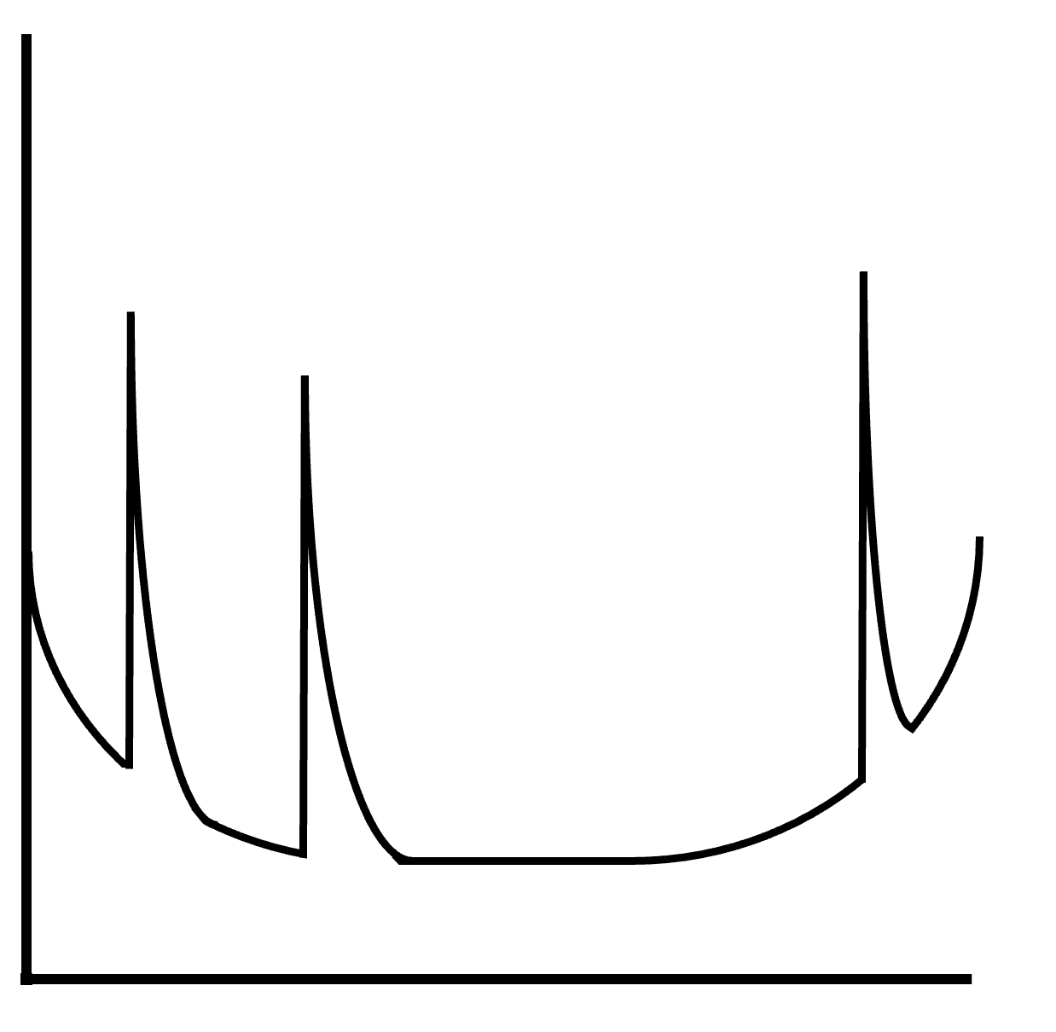
Accurate Per-Node Fault Curves
Software Update
Cluster Reconfiguration
Node Restarts
Probability of Failure
Time
Notes:
Our key idea to accomplish this is by providing the abstraction of a per-node fault curve
this would provide system designers with how a machine’s fault rate changes over time
It will look something like this: We have time on the x-axis and the fault probability of a machine on the y-axis
If there are planned software updates, node restarts, or cluster reconfiguration,

Slide 30
Accurate Per-Node Fault Curves
Software Update
Cluster Reconfiguration
Node Restarts
Probability of Failure
Time
Notes:
They cause the fault rate of the machine to increase for those brief time periods
We can create this model because datacenters have tons of historical data about hardware, software, and operational failure rates
And we can rely on these fault curves to accurately capture reality

Slide 31
Potential Opportunities
Protocols can better utilize reliable nodes
Larger clusters of less reliable nodes can help
Explore constant instead of linear size quorums
Exploit the tradeoff between safety and liveness
Notes:
I’ll now outline a few potential opportunities from our preliminary analysis
Starting simple, If consensus protocols are aware of the probabilistic nature of faults, They can better utilize reliable nodes
Larger clusters of less reliable nodes can help
<pause…>
And More radically… they might even be able to do better than Linear size quorums
In the interest of time, I'll just focus on these three opportunities in this talk

Slide 32
Potential Opportunities
Protocols can better utilize reliable nodes
Larger clusters of less reliable nodes can help
Explore constant instead of linear size quorums
Exploit the tradeoff between safety and liveness
Notes:
In our paper, we also explore the hidden trade-off between safety and liveness;
And we encourage all of you to check it out for more details

Slide 33

1. Protocols can better utilize reliable nodes
Cluster-1
Cluster-2
Both clusters guarantee safety and liveness
Cluster-2 tolerates $f=3$ faults
Notes:
First, Consider two clusters:
One on the left with 3 nodes and one on the right with seven nodes
Traditional consensus guarantees that both these clusters provide safety and liveness
But the second cluster can tolerate more failures so IF YOU DIDN’T KNOW ANYTHING about failure rates, you might consider it to be more reliable.
But!! if you bring that back into the picture,

Slide 34
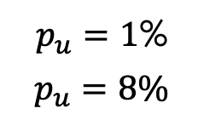
1. Protocols can better utilize reliable nodes
$p_{u}=1$%
$$p_{u}=8\%$$
Cluster-1
Cluster-2
Three 9s
Two 9s
With fault rates, they achieve 9s of safety and liveness
Notes:
If the second cluster has a higher failure rate of 8% shown here in dark red, compared to the first cluster’s more reliable 1% failure rate shown in light red
Then our probabilistic analysis shows us that the first cluster is actually 10 times more likely to be safe and live.
---------
Raft and
PBFT are oblivious to fault curves. Consider a seven node
cluster with 𝑝𝑢 =8% nodes running Raft. This cluster is 99.88%
safe (Table 2). If we replace three nodes with more reliable
ones (𝑝𝑢 =1%)—almost half of the nodes—safety improves
only to 99.98% (not shown in table). As Raft does not know
which nodes are more reliable, it may persist data only on
the unreliable nodes. If we required quorums to include at
least one reliable node (by leveraging knowledge of fault
curves), data durability would increase to 99.994%.

Slide 35
1. Protocols can better utilize reliable nodes
$p_{u}=1$%
$$p_{u}=8\%$$
Cluster-3
Leader selection from more reliable nodes
Skewing quorums to include reliable nodes
Three 9s
Protocols can leverage accurate fault rates for better guarantees
Notes:
And in more realistic scenarios where you have non-uniform servers…
You could use fault probability knowledge to select leaders more effectively
or even skew quorums to include more reliable nodes
This can help provide better guarantees for applications

Slide 36
2. Larger clusters of less reliable nodes can help
$p_{u}=1$%
$$p_{u}=8\%$$
Cluster-1
Cluster-2
Three 9s
Three 9s
Notes:
Now here, consider a 3 node cluster on the left with more reliable nodes
and a 9 node cluster on the right with less reliable nodes
we observe that we can actually match guarantees
with larger clusters of less reliable nodes!
This means, we could use cheaper, less reliable hardware with no downsides in our end-to-end guarantees. This can help increase the usable life of hardware for sustainable systems
I’ve told you two ways how fault probabilities can change the way we work with existing consensus protocols, now let me share a more radical direction

Slide 37
2. Larger clusters of less reliable nodes can help
$p_{u}=1$%
$$p_{u}=8\%$$
Cluster-1
Cluster-2
Cluster-2
Three 9s
Two 9s
Three 9s
Notes:
Now if we return to our prior example, we find that even though, the right cluster has less reliable nodes,
We actually CAN match guarantees between the clusters. We just need to add two more nodes <>
While this may seem like a tough sell, there are situations where you may want to use less reliable nodes.
For example, they can be far cheaper to operate, and making use of older, less reliable, hardware can be more sustainable than using brand new machines.
So far, I’ve told you two ways how fault probabilities can change the way we work with existing consensus protocols, now let me share a more radical direction

Slide 38
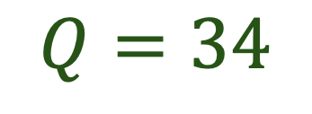
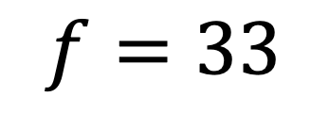
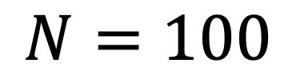
3. Exploring constant size quorums
$$N=100$$
$$f=33$$
$$Q=34$$
Notes:
In traditional consensus, we assume a large portion of the network is faulty.
Here, <> if this diagram represents a large <> 100 node Byzantine Fault Tolerant consensus deployment, then the F threshold model tells us that one in three nodes<> may fail
So to reach a correct node we <> __must__ reach out to more than a third of our network. <>
However! <> Even if we are suffering what is effectively a 33% fault rate, each individual machine is more likely than not to be correct!!
This means that if I reach out to a single machine,

Slide 39
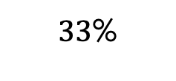
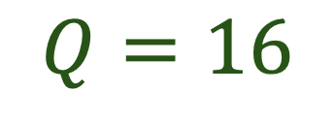
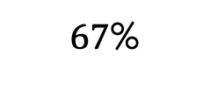
3. Exploring constant size quorums
$67$%
$33$%
$$N=100$$
$$f=33$$
$$Q=34$$
$$Q=16$$
Notes:
, even if we are suffering what is effectively a 33% fault rate, each individual machine is more likely than not to be correct!!
<>
From that logic, we find that with a random sample<>, we can do less than half the amount of work and still reach a correct node with 10 nines of probability

Slide 40
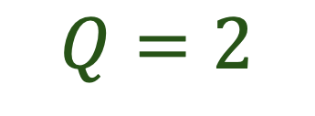
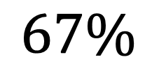
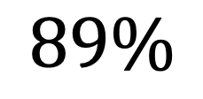
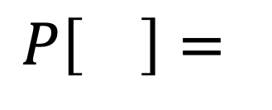
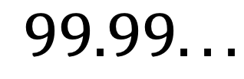


3. Exploring constant size quorums
$$N=100$$
$$f=33$$
$$Q=2$$
$$Q=1$$
$$Q=18$$
$$Q=34$$
$$99.99...$$
$$67\%$$
$$P\left[\right]=$$
$$89\%$$
✅
Notes:
Then I'm more than likely to have already reached a correct node
Then if I talk to two nodes <> our probability of success will exponentially increase…
And when I reach out to 18 nodes, half the amount from before, I will have reached a correct node with 10 nines of probability.

Slide 41

Probabilistic Consensus for Real World!
Current fault models fail to accurately capture reality
Today, consensus is probabilistic – like it or not!
Accurate fault curves for better fault modeling
Probability-native consensus protocols
More efficient, cost-effective, and sustainable, and reliable
soujanya@berkeley.edu
reginaldfrank77@berkeley.edu
Notes:
<KEEP QUESTIONS SHORT SHORRRRTTTTT>
So overall
today I hope I’ve convinced you that current fault models fail to accurately capture reality
Consensus is already probabilistic like it or not
And that we can improve fault modeling in consensus by leveraging existing hardware knowledge
Then, in the long run, we want to design Probability-native consensus protocols
that are more efficient, cost-effective, sustainable, and reliable!
By the way, I wanted to mention that my co-presenter soujanya is on the job market this year, I'm not yet, so please forward all your job opportunities her way!
Thanks!
<KEEP QUESTIONS SHORTTTTTT>

Slide 42

3. Exploring constant size quorums
$$N=100$$
$$f=33$$
$$Q=5$$
Notes:
In PBFT quorums are required to scale linearly with the size of the network.
This is a huge problem because people often want to deploy large clusters of Byzantine Fault Tolerant consensus protocols.
Here, if this grey box represents a 100 node PBFT deployment, the F threshold model tells us we to reach a correct node we __must__ reach out to a third of our network.
However, even if a third of our network is failed, we can do half the work and still be correct with 10 nines of probability
But more realistically, a tiny sample of 5 nodes is able to reach a correct node with 10 nines of probability if we believe in a 1% failure rate per machine.

Slide 43

Consensus in the Real World
Fault Model
Write (k1, v1)
Write (k2, v2)
$$f=0$$
Notes:
Continuing with our key value store example,
If my fault model claims that I will have no failures, then I can easily implement a key value store by having a single machine order and store each request in a log

Slide 44

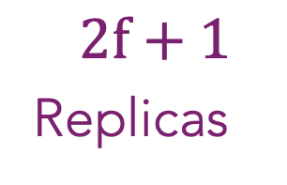
Consensus in the Real World
Fault Model
Write (k1, v1)
Write (k2, v2)
Write (k1, v1)
Write (k2, v2)
$$f=1$$
Write (k1, v1)
Write (k1, v1)
Write (k2, v2)
Write (k2, v2)
$$2f+1$$
Replicas
Notes:
When failures may occur, protocols like raft will deploy a network of 2f+1 nodes for f failures and then replicate the data across each node
In our example, f=1, so we have 3 replicas.
Now even if one machine fails, the other two can continue working together

Slide 45


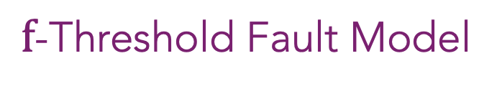
Consensus in the Real World
Write (k1, v1)
Write (k2, v2)
Write (k1, v1)
Write (k2, v2)
Write (k1, v1)
Write (k2, v2)
Consensus Guarantees
when failures$≤f$
$f$-Threshold Fault Model
Notes:
In general we use f to denote the number of machines which may fail. And our guarantees of safety and liveness only apply while the number of failures is <= f
When we talk about anything referring to f we’ll be referring to this

Slide 46
Accurate Fault Curves
Encapsulate all potential sources of failure a node may encounter
Time variable as sources of failure change over time
We collect this information already! Let's use this for consensus

Slide 47
1. Protocols can better utilize reliable nodes
RAFT and PBFT underutilize reliable nodes
Replacing 3 of 7 nodes with more reliable ones (1% instead of 8% fault rate); safety improves from 99.88% only to 99.98%.
Notes:
A straight fwd
Cite work that already uses these approaches already
As Raft does not know
which nodes are more reliable, it may persist data only on
the unreliable nodes. If we required quorums to include at
least one reliable node (by leveraging knowledge of fault
curves), data durability would increase to 99.994%.
Raft and
PBFT are oblivious to fault curves. Consider a seven node
cluster with 𝑝𝑢 =8% nodes running Raft. This cluster is 99.88%
safe (Table 2). If we replace three nodes with more reliable
ones (𝑝𝑢 =1%)—almost half of the nodes—safety improves
only to 99.98% (not shown in table). As Raft does not know
which nodes are more reliable, it may persist data only on
the unreliable nodes. If we required quorums to include at
least one reliable node (by leveraging knowledge of fault
curves), data durability would increase to 99.994%.

Slide 48
1. Protocols can better utilize reliable nodes
RAFT and PBFT underutilize reliable nodes
Replacing 3 of 7 nodes with more reliable ones (1% instead of 8% fault rate); safety improves from 99.88% only to 99.98%.
Notes:
A straight fwd
Cite work that already uses these approaches already
As Raft does not know
which nodes are more reliable, it may persist data only on
the unreliable nodes. If we required quorums to include at
least one reliable node (by leveraging knowledge of fault
curves), data durability would increase to 99.994%.
Raft and
PBFT are oblivious to fault curves. Consider a seven node
cluster with 𝑝𝑢 =8% nodes running Raft. This cluster is 99.88%
safe (Table 2). If we replace three nodes with more reliable
ones (𝑝𝑢 =1%)—almost half of the nodes—safety improves
only to 99.98% (not shown in table). As Raft does not know
which nodes are more reliable, it may persist data only on
the unreliable nodes. If we required quorums to include at
least one reliable node (by leveraging knowledge of fault
curves), data durability would increase to 99.994%.

Slide 49
Probability-Native Consensus
Low cost passive backups may improve durability without hurting system performance
Replacing hardware as it ages becomes a key protocol consideration
How durable must an operation be before replying to users?
Notes:
Beyond this we can try and envision what a consensus protocol might look like if we went further and redesigned a protocol from scratch
What might this mean?

Slide 50
End-to-End Probabilistic Guarantees
Understandable Guarantees
  X% safe, live, durable, available
Solvers which can optimize and balance throughput/latency with durability and availability
Notes:
This alone can sidestep many of the issues we talked about prior. And we see two additional benefits
Given a more detailed model of how the world works, we can report guarantees beyond what traditional consensus can.
This includes, more accurate metrics on the durability and availability of a system

Slide 51
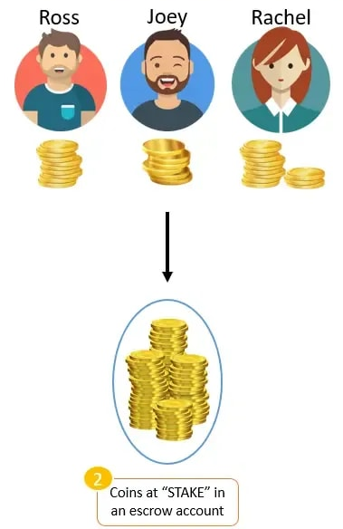
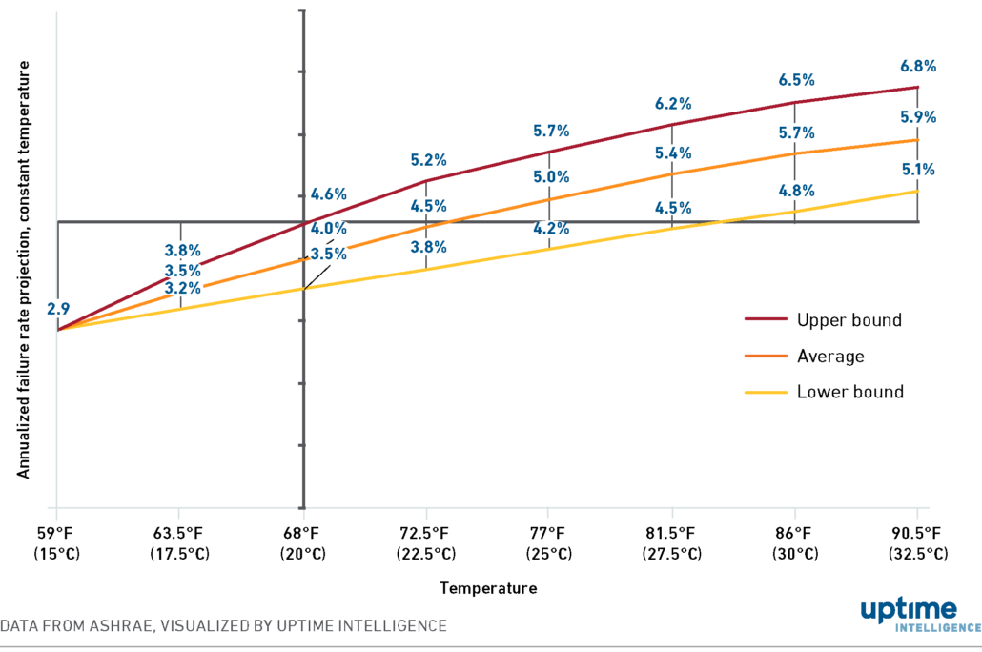
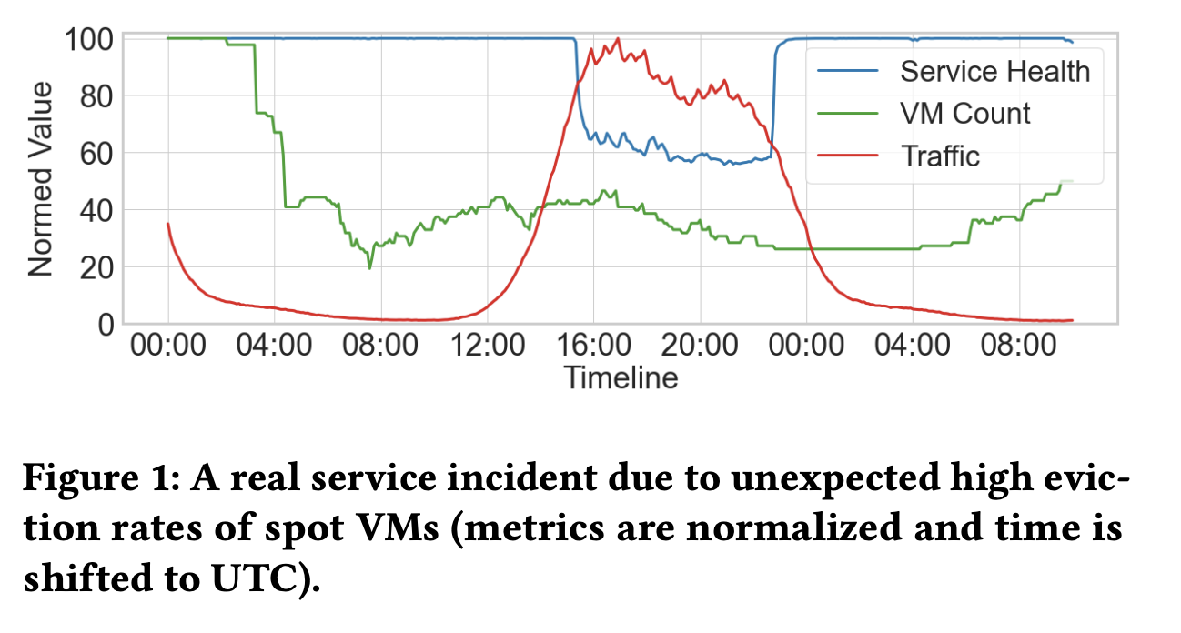
(a) Faults are not uniform
[1] Snape: Reliable and Low-Cost Computing with Mixture of Spot and On-Demand VMs, ASPLOS’23
[2] Memory-Harvesting VMs in Cloud Platforms, ASPLOS’22
Notes:
We observe that faults are not uniform… they are rarely homogenous in practice!
For example, servers that are improperly cooled experience a higher failure rate
And considering the cloud with different offerings, a spotVM is more likely to fail than a standard VM!
In some systems, the non-uniform failure rate can capture more complex, trust dynamics where I need not trust all components equally.
Consider blockchains, that are stake-based: alice here with a higher stake has more to lose if the system fails and so I could trust her to avoid failure.

Slide 52
Consensus Guarantees are a Mismatch
All-or-nothing guarantees
100% - $ε$ guarantees
Safe and Live
when failures$≤f$
Undefined guarantees
if failures$>f$
Live vs Available: System that is live could also be 0% available
Live is only eventual; availability bounds system downtime!
Probabilistic guarantees better match application demands!
Notes:
But, in practice,
Every node has a non-zero probability of failure and eventually every single node will fail.
So, systems can not guarantee100% guarantees!
More fundamentally, safety and liveness properties do not match with how applications think about guarantees!
For example, a system that is Live could also be 0% available… making it unusable for the application.
So, ideally, we want probabilistic guarantees that are a better match with application demands!

Slide 53
Consensus is also Probabilistic — Like it or not!
Raft is only 99.97% safe and live in three-node deployments where nodes have a 1% failure rate!

Slide 54
Key challenge: Simple abstractions
Traditional Consensus
Single parameter to decide number of replicas
Traditional safety and liveness guarantees
Probabilistic consensus doesn’t mean complex!
(a) Accurate fault curves
(b) Probability-native consensus
(c) Probabilistic guarantees
Notes:
But the key challenge is that more information does not inherently make a model more useful!
The biggest strength of the existing f threshold model is that it is simple to understand and work with.
In order for us to make use of our new information, we must similarly

Slide 55
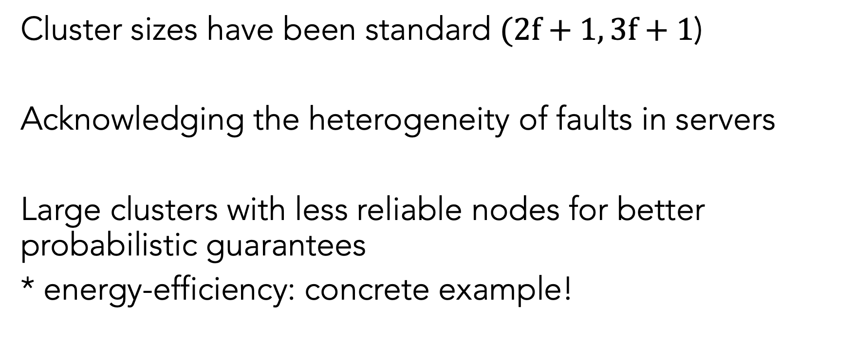
Larger clusters of less reliable nodes can help
Cluster sizes have been standard $(2f+1, 3f+1$)
Acknowledging the heterogeneity of faults in servers
Large clusters with less reliable nodes for better probabilistic guarantees
* energy-efficiency: concrete example!
Notes:
Linear size quorums and
f+1 for honest nodes o(n)
But it turns out “random” sampling!!!! Can do better with knowledge of failure probabilities
Random Sampling!

Slide 56
Larger clusters of less reliable nodes can help
Shout out to research that already utilizes these ideas~
What is our delta novelty-wise?

Slide 57
1. Protocols can better utilize reliable nodes
Protocols can avoid less reliable nodes for leaders!
(There are works that take this approach for leader-election)
In addition, leveraging the knowledge of fault curves, quorums can be required to have more reliable nodes, which increases data durability to 99.994%

Slide 58

2. Linear size quorums can be overkill
$$N=100$$
$$f=33$$
$$Q=5$$
$$Q=34$$
$$Q=16$$
Notes:
In PBFT quorums are required to scale linearly with the size of the network.
This is a huge problem because people often want to deploy large clusters of Byzantine Fault Tolerant consensus protocols.
Here, if this grey box represents a 100 node PBFT deployment, the F threshold model tells us we to reach a correct node we __must__ reach out to a third of our network.
However, even if a third of our network is failed, we can do half the work and still be correct with 10 nines of probability
But more realistically, a tiny sample of 5 nodes is able to reach a correct node with 10 nines of probability if we believe in a 1% failure rate per machine.

Slide 59
2. Linear size quorums can be overkill
Quorums in PBFT and Raft (§3.1) grow linearly with the network size.
For example, quorum in PBFT is at linear in size of f+1 nodes; in a cluster of 100 nodes, it is 34 nodes!
This is an overkill!
Notes:
Quorums in
PBFT and Raft (§3.1) grow linearly with the network size.
For instance, an 𝑄𝑣𝑐
𝑡 quorum is at least 𝑓 +1 in size
_
(𝑁= 100,|𝑄𝑣𝑐
𝑡 |= 34) to ensure that at least one correct **Diem
_
node requests a view change [15]. This is overkill: if 𝑝𝑢 = 1%,
there are already ten nines of probability that a random
quorum of five nodes includes at least one correct node.

Slide 60
2. Linear size quorums can be overkill
Ideally, view change quorum require at least one correct node
And from our analysis, if we set 𝑝𝑢 = 1%, a quorum of five randomly sampled nodes includes at least one correct node.
It already guarantees this with ten nines of probability
Revisit random sampling and constant-sized quorums!

Slide 61
2. Linear size quorums can be overkill
Notes:
In PBFT quorums are required to scale linearly with the size of the network which is a huge problem because people often want to deploy large clusters of Byzantine Fault Tolerant protocols
If this grey box represents a 100 node PBFT deployment similar to what we find in diem (Does diem deploy pbft?)
Then this

Slide 62
2. Linear size quorums can be overkill
Notes:
In PBFT quorums are required to scale linearly with the size of the network which is a huge problem because people often want to deploy large clusters of Byzantine Fault Tolerant protocols
If this grey box represents a 100 node PBFT deployment similar to what we find in diem (Does diem deploy pbft?)
Then this

Slide 63
2. Linear size quorums can be overkill
Notes:
In PBFT quorums are required to scale linearly with the size of the network which is a huge problem because people often want to deploy large clusters of Byzantine Fault Tolerant protocols
If this grey box represents a 100 node PBFT deployment similar to what we find in diem (Does diem deploy pbft?)
Then this

Slide 64
Example: Probabilistic Quorum Overlap
Traditional Consensus
Probabilistic consensus
f+1 nodes form a 100*% durable quorum
Sample N-f nodes to 100*% ensure quorums overlap
Sample nodes who have ≥X% chance of not failing together
Sample nodes who intersect with ≥Y% probability
* As long as ≤f nodes fail
Notes:
For example, a key component of all standard consensus protocols is that they will

