Slide 1




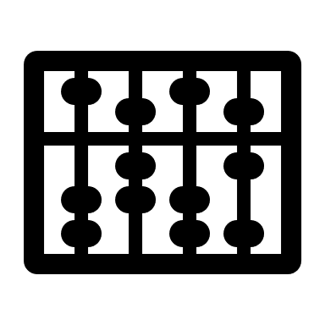






Everyone Else is Using ML, Why Aren’t We?
Widespread adoption in other domains
AlphaGo
AlphaFold
ChatGPT
CoPilot
AlphaProof
And learned systems
Cluster Scheduling
[Decima (SIGCOMM’20)]
Query Optimization
[Neo (VLDB’19), Bao (SIGMOD’22)]
Configuration Tuning
[SelfTune (NSDI’23), MLOS (VLDB’24)]
Notes:
Since we are at HotOS, let’s start with a hot take – everyone seems to be using Machine Learning, why aren’t we?
ML has taken over so many disciplines, ranging from [RET] games, protein discovery, web search, programming and software engineering, and now even math.
[RET] there has been a lot of success for ML in several other systems such as: cluster scheduling; [RET] query optimization; and [RET] tuning cloud configuration knobs.
[RET] Me and my labmates got jealous and wanted to use ML too! Is it a good idea? Turns out that it might actually be a good idea!
[RET] Operating Systems manage several resources such as: processors, memory, network devices and file and storage devices. OSes today are subject to diverse applications, with varying performance requirements.
[RET] These applications can be deployed in several environments, such as a server on the cloud, robots, mobile devices, and edge base stations! This requires that the OS policies be dynamic and adaptive.
[RET] And this is where we can exploit the capability of Machine Learning to use a rich set of features, especially in the temporal domain.
Now, I know what several of you are thinking. [RET]

Slide 2
Everyone Else is Using ML, Why Aren’t We?
Widespread adoption in other domains
Does using ML in the OS make sense?
AlphaGo
AlphaFold
ChatGPT
CoPilot
AlphaProof
And learned systems
Cluster Scheduling
[Decima (SIGCOMM’20)]
Query Optimization
[Neo (VLDB’19), Bao (SIGMOD’22)]
Configuration Tuning
[SelfTune (NSDI’23), MLOS (VLDB’24)]
Notes:
Since we are at HotOS, let’s start with a hot take – everyone seems to be using Machine Learning, why aren’t we?
ML has taken over so many disciplines, ranging from [RET] games, protein discovery, web search, programming and software engineering, and now even math.
[RET] there has been a lot of success for ML in several other systems such as: cluster scheduling; [RET] query optimization; and [RET] tuning cloud configuration knobs.
[RET] Me and my labmates got jealous and wanted to use ML too! Is it a good idea? Turns out that it might actually be a good idea!
[RET] Operating Systems manage several resources such as: processors, memory, network devices and file and storage devices. OSes today are subject to diverse applications, with varying performance requirements.
[RET] These applications can be deployed in several environments, such as a server on the cloud, robots, mobile devices, and edge base stations! This requires that the OS policies be dynamic and adaptive.
[RET] And this is where we can exploit the capability of Machine Learning to use a rich set of features, especially in the temporal domain.
Now, I know what several of you are thinking. [RET]

Slide 3










Everyone Else is Using ML, Why Aren’t We?
Widespread adoption in other domains
Does using ML in the OS make sense?
AlphaGo
AlphaFold
ChatGPT
CoPilot
AlphaProof
Processor
Memory
And learned systems
Network
File and Storage
Operating System
Cluster Scheduling
[Decima (SIGCOMM’20)]
Query Optimization
[Neo (VLDB’19), Bao (SIGMOD’22)]
OS is subject to diverse applications and environments, necessitating dynamic and adaptive policies!
Configuration Tuning
[SelfTune (NSDI’23), MLOS (VLDB’24)]
Exploit the capability of ML of using rich features and take predictive actions!
Notes:
Since we are at HotOS, let’s start with a hot take – everyone seems to be using Machine Learning, why aren’t we?
ML has taken over so many disciplines, ranging from [RET] games, protein discovery, web search, programming and software engineering, and now even math.
[RET] there has been a lot of success for ML in several other systems such as: cluster scheduling; [RET] query optimization; and [RET] tuning cloud configuration knobs.
[RET] Me and my labmates got jealous and wanted to use ML too! Is it a good idea? Turns out that it might actually be a good idea!
[RET] Operating Systems manage several resources such as: processors, memory, network devices and file and storage devices. OSes today are subject to diverse applications, with varying performance requirements.
[RET] These applications can be deployed in several environments, such as a server on the cloud, robots, mobile devices, and edge base stations! This requires that the OS policies be dynamic and adaptive.
[RET] And this is where we can exploit the capability of Machine Learning to use a rich set of features, especially in the temporal domain.
Now, I know what several of you are thinking. [RET]

Slide 4
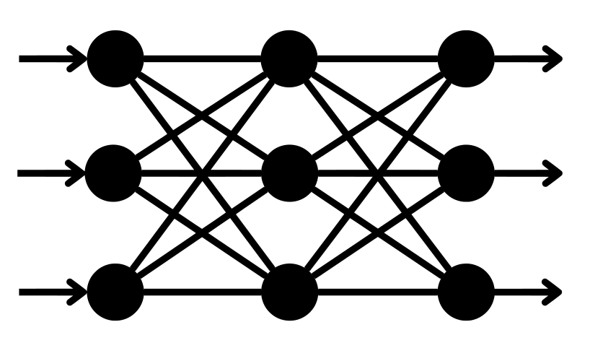





“Keep Your Damn Models Out of My Kernel!”
Policy
?
?
?
Feature Vector
Unsafe
Decision
Unsafe decisions because of incomplete training/unseen inputs
Opaque decisions undermine reproducibility and compromise security.
Inputs
Output
Inputs
Output
Performance overheads of using learning-based policies
Notes:
“Keep your damn models out of my kernel”
And I understand why. Starting out, me and my collaborators got several legitimate concerns.
[RET] Concerns such as models can make unsafe decisions, we do not know which inputs may trigger such decisions.
[RET] There were also concerns about the opaqueness of learned models. Especially, when used in a bigger system with a bunch of code around it, it is hard to reproduce bugs.
[RET] Another concern was that learned models may be significantly slower than manually written heuristics, and hence ill-suited for kernel operations that need to be very fast.
All these criticisms are justified, but we managed to convince our advisors that

Slide 5




How I learned to stop worrying and love learned OS policies
Divyanshu Saxena*, Jiayi Chen*, Sujay Yadalam, Yeonju Ro, Rohit Dwivedula, Eric Campbell, Aditya Akella, Christopher Rossbach, Michael Swift
Notes:
... That we can stop worrying about these roadblocks and love learned OS policies. In this talk, I am going to share our initial thoughts on how we can do this.
This talk is based on joint work with my collaborators at The University of Texas at Austin and University of Wisconsin-Madison; and this is a part of an ongoing project named LDOS, for Learning-directed Operating Systems

Slide 6
Guardrails for OS Policies
Enable learned policies where beneficial and avoid catastrophic outcomes.
Notes:
To address the challenges of using Machine Learning in the OS, let me introduce you to our friend, the OS Guardrail.
To understand what an OS guardrail means, let’s draw an analogy.
[RET] One may be terrified to drive on this road -- a single mistake could send you hurdling down valley below;
[RET] However, just adding a guardrail provides significant confidence and one can scale the heights and enjoy the views that lie beyond.
[RET] Similarly, an OS guardrail enables use of ML policies where it is beneficial and avoiding undesirable outcomes.
[RET]

Slide 7


Guardrails for OS Policies
Enable learned policies where beneficial and avoid catastrophic outcomes.
Notes:
To address the challenges of using Machine Learning in the OS, let me introduce you to our friend, the OS Guardrail.
To understand what an OS guardrail means, let’s draw an analogy.
[RET] One may be terrified to drive on this road -- a single mistake could send you hurdling down valley below;
[RET] However, just adding a guardrail provides significant confidence and one can scale the heights and enjoy the views that lie beyond.
[RET] Similarly, an OS guardrail enables use of ML policies where it is beneficial and avoiding undesirable outcomes.
[RET]

Slide 8
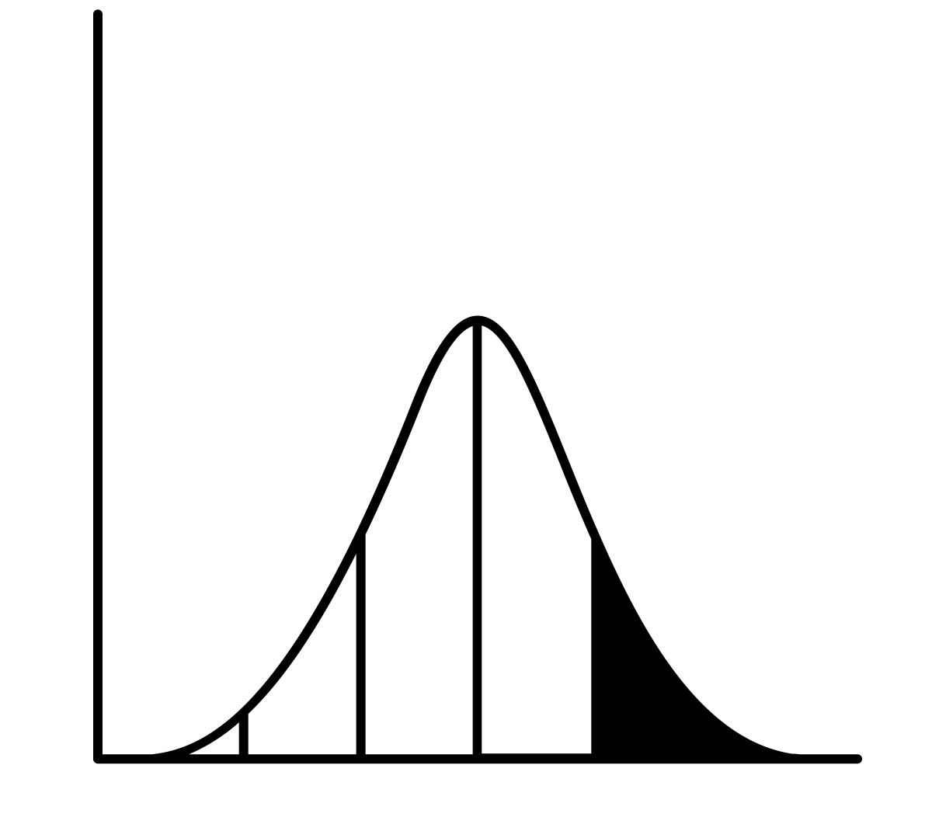

A Guardrail Case Study – I/O Latency Predictor
Task: Predict whether an I/O access will be slow or fast [LinnOS (OSDI’20)]
Trained using the latency distribution of current workload.
Workload Latencies
Trained Model
Application
I/O access
Revoke
Kernel
Features
Latencies of recent I/Os
Number of pending I/Os
Slow
Fast
SSD
Notes:
Let’s start with a concrete example to understand the issues of using a learned OS policy and what a guardrail ought to do.
We take LinnOS, which appeared at OSDI, as a running example. In LinnOS, the task is to predict whether an I/O request to an SSD will be slow or fast.
[RET] LinnOS uses the latencies of recent I/Os and the number of pending I/Os in the recent history to predict between slow/fast.
[RET] If the model predicts fast, the request is forwarded to the device else it is revoked back to the application.
[RET] To train this model and crucially, to chose the threshold for slow vs fast accesses, LinnOS relies on the latency distributions of the current workload.
Now let’s understand what guardrails need to do when running LinnOS in the kernel.

Slide 9





Detecting When Things Go Wrong
Detect potential issues by monitoring inputs, outputs and system behavior.
$$f$$
Slow
$$f+ϵ$$
Fast?
Out-of-distribution inputs: Workload changes can change the fast/slow threshold.
Poor decisions because of noise: Model may yield different outputs for similar inputs.
Poor end-to-end performance: Gains of good decisions may be negated by model overhead.
LinnOS Policy
Input
Features
System Behavior
Output
Notes:
The first part of a guardrail, we think, is detection of problems. Problems can arise because of inputs to the model, its outputs and system behavior.
[RET] One problem with the inputs is that if the input is outside of the training data distribution, the model’s outputs can be arbitrary. Because remember in LinnOS, the workload decides the fast/slow threshold so if the workload changes significantly, this threshold might need to change. This can be detected by monitoring the inputs to the model.
[RET] Another problem could be related to model outputs. For example, a small noise in the input features may lead to different outputs because of the statistical nature of the neural network predictions used in LinnOS. This can be detected by monitoring the inputs and outputs of the model.
[RET] Finally we would also like to have good end-to-end performance. For example, one problem that may arise here is that if the decisions do not lead to performance gains higher than the model overheads, then the overall performance regresses.
I described these examples for LinnOS but we also looked at other learned policies and found similar issues could exist there.
[RET] So a guardrail should detect when any of these problems arise.
Also note that such problems may also occur with the heuristic policies used in the kernel today but without any detection mechanism, we do not detect them.

Slide 10




Recovering from Undesirable Outcomes
Simple detection is not enough ⇒ Automatic recovery when problems arise.
Report to log on an incorrect prediction.
Replace model with a hedging-based heuristic.
Retrain the latency prediction model.
Deprioritize kswapd to reduce I/O requests.
LinnOS Policy
Input
Features
System Behavior
Output
Notes:
The second part is recovery. In particular, simply detecting when undesirable outcomes happen is not enough, the system must also be able to automatically recover whenever any of the previously described problems occur.
So let’s think what actions the OS can take.
These actions can range in complexity and impact.
[RET] One simple action could be to simply report the inputs and system state to a log, for example, log whenever the model leads to a false submit.
[RET] We may replace the model with a fallback policy. The fallback can be the default policy or some other heuristic that we have a better understanding over. For example, for LinnOS, one that can use a heuristic based on hedging to get good performance.
[RET] Another action could be to retrain the model. Especially, inputs that cause such problems, can constitute crucial training data for training robust models.
[RET] Another recovery action that the OS can take given its privileges, is to deprioritize or relegate background tasks in order to free resources for applications. For example, stopping the kswapd kernel daemon that may send I/O requests that hamper with the prediction model.
By detecting problems and taking corrective actions, guardrails make learned policies safer for the OS.
Let us now try to synthesize the two points we discussed, about detection of problems and taking corrective actions, into the Guardrail abstraction,

Slide 11
The Guardrail Abstraction
Example Properties:
In-distribution inputs
Robustness to noise
Better performance than default
Property
Action
Example Actions:
Report
Replace
Retrain
Deprioritize
Description of desired behaviors, constraints and invariants.
Prescriptions for system responses when a property is violated
Input
Features
Learning-based Policy
System Behavior
Notes:
[RET] The first part of a guardrail is a property. Properties reflect the issues we discussed when deploying machine learning. These codify bad behaviors to avoid or desirable behaviors to have, such as the examples we saw for LinnOS.
[RET] The guardrail can then consistently check whether these properties hold or not.
Note that specifying such properties, are often simpler than specifying the full policy. For example, specifying the fairness condition for a scheduler is easier than devising a full scheduler, that is fair and performant.
[RET] The second part of the guardrail is about recovery, or the corrective actions that the OS should take, like the ones we saw for LinnOS.
[RET] These actions should be taken whenever the property be violated.
[RET] Note that this notion of tracking properties and taking recovery actions is an introspective action, something that today’s OS do not provide.
[RET]

Slide 12

The Guardrail Abstraction
Example Properties:
In-distribution inputs
Robustness to noise
Better performance than default
Property
Action
Example Actions:
Report
Replace
Retrain
Deprioritize
Description of desired behaviors, constraints and invariants.
Prescriptions for system responses when a property is violated
Input
Features
Learning-based Policy
System Behavior
Notes:
[RET] The first part of a guardrail is a property. Properties reflect the issues we discussed when deploying machine learning. These codify bad behaviors to avoid or desirable behaviors to have, such as the examples we saw for LinnOS.
[RET] The guardrail can then consistently check whether these properties hold or not.
Note that specifying such properties, are often simpler than specifying the full policy. For example, specifying the fairness condition for a scheduler is easier than devising a full scheduler, that is fair and performant.
[RET] The second part of the guardrail is about recovery, or the corrective actions that the OS should take, like the ones we saw for LinnOS.
[RET] These actions should be taken whenever the property be violated.
[RET] Note that this notion of tracking properties and taking recovery actions is an introspective action, something that today’s OS do not provide.
[RET]

Slide 13
The Guardrail Abstraction
Example Properties:
In-distribution inputs
Robustness to noise
Better performance than default
Property
Action
Example Actions:
Report
Replace
Retrain
Deprioritize
Description of desired behaviors, constraints and invariants.
Prescriptions for system responses when a property is violated
Input
Features
Learning-based Policy
System Behavior
Need introspective support to monitor properties at run time and take corrective actions.
Notes:
[RET] The first part of a guardrail is a property. Properties reflect the issues we discussed when deploying machine learning. These codify bad behaviors to avoid or desirable behaviors to have, such as the examples we saw for LinnOS.
[RET] The guardrail can then consistently check whether these properties hold or not.
Note that specifying such properties, are often simpler than specifying the full policy. For example, specifying the fairness condition for a scheduler is easier than devising a full scheduler, that is fair and performant.
[RET] The second part of the guardrail is about recovery, or the corrective actions that the OS should take, like the ones we saw for LinnOS.
[RET] These actions should be taken whenever the property be violated.
[RET] Note that this notion of tracking properties and taking recovery actions is an introspective action, something that today’s OS do not provide.
[RET]

Slide 14


Providing Support for OS Guardrails
High-level interface to specify guardrails
Policy/Subsystem
Input
Features
System Behavior
Output
Notes:
How do we support the guardrail abstraction. Let’s think about it.
As we all know, maintaining the kernel is already very hard – with tons of mechanisms and policy and their interplay. And we do not want to add more burden on OS developers wanting to use learned policies.
[RET] Therefore, we need a rich high-level interface for OS practitioners to specify the diverse set of the properties and actions desired for various OS policies.
[RET] This specification can then be compiled into guardrails running in the kernel.
In the remaining few slides, I will present an initial proposal on how to design and implement the interface.

Slide 15


Guardrail Interface – Specifying Properties
Properties and Actions
Interface Grammar
〈Guardrail〉 ::= 〈Property〉 〈Action〉+
〈Property〉 ::= 〈Trigger〉+ 〈Rule〉+
〈Trigger〉 ::= TIMER | FUNCTION
〈Rule〉 ::= 〈Expression〉
Notes:
When we started on the Interface, we came up with a Grammar for what the Interface should support.
[RET] As discussed before, a guardrail consists of properties and actions.
[RET] For properties, we decompose them into two parts: rules and triggers. The rule specify the expression to check and trigger specifies when to check for this rule.
[RET] Recalling the example properties from LinnOS, we can extract the [RET] rules being checked, shown in the red highlight, and [RET] the trigger, shown in blue highlight.
Note that the rules can be expressed using logical expressions as described for these three examples.
Triggers can be one of two types. One type of trigger specifies to check the rule at specific events, such as model invocations as in the first two properties here; or checking periodically at regular intervals, such as the third example shown.
This decoupling of properties into triggers and rules allows developers to trade-off monitoring overheads for swiftness of violation detection.

Slide 16
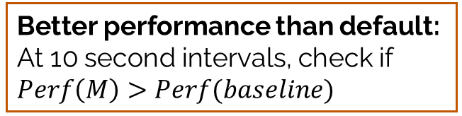
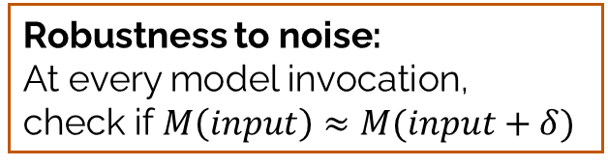
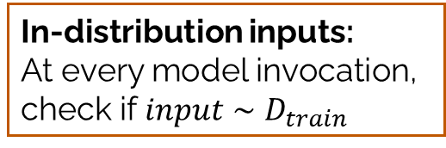
Guardrail Interface – Specifying Properties
Properties and Actions
Interface Grammar
〈Guardrail〉 ::= 〈Property〉 〈Action〉+
〈Property〉 ::= 〈Trigger〉+ 〈Rule〉+
〈Trigger〉 ::= TIMER | FUNCTION
〈Rule〉 ::= 〈Expression〉
In-distribution inputs:
At every model invocation, check if $input∼D_{train}$
Robustness to noise:
At every model invocation,
check if $M\left(input\right)≈M(input+δ)$
Better performance than default: At 10 second intervals, check if $Perf\left(M\right)>Perf(baseline)$
Notes:
When we started on the Interface, we came up with a Grammar for what the Interface should support.
[RET] As discussed before, a guardrail consists of properties and actions.
[RET] For properties, we decompose them into two parts: rules and triggers. The rule specify the expression to check and trigger specifies when to check for this rule.
[RET] Recalling the example properties from LinnOS, we can extract the [RET] rules being checked, shown in the red highlight, and [RET] the trigger, shown in blue highlight.
Note that the rules can be expressed using logical expressions as described for these three examples.
Triggers can be one of two types. One type of trigger specifies to check the rule at specific events, such as model invocations as in the first two properties here; or checking periodically at regular intervals, such as the third example shown.
This decoupling of properties into triggers and rules allows developers to trade-off monitoring overheads for swiftness of violation detection.

Slide 17
Guardrail Interface – Specifying Properties
Properties and Actions
Interface Grammar
〈Guardrail〉 ::= 〈Property〉 〈Action〉+
〈Property〉 ::= 〈Trigger〉+ 〈Rule〉+
〈Trigger〉 ::= TIMER | FUNCTION
〈Rule〉 ::= 〈Expression〉
In-distribution inputs:
At every model invocation, check if $input∼D_{train}$
Robustness to noise:
At every model invocation,
check if $M\left(input\right)≈M(input+δ)$
Better performance than default: At 10 second intervals, check if $Perf\left(M\right)>Perf(baseline)$
RULE
TRIGGER
Notes:
When we started on the Interface, we came up with a Grammar for what the Interface should support.
[RET] As discussed before, a guardrail consists of properties and actions.
[RET] For properties, we decompose them into two parts: rules and triggers. The rule specify the expression to check and trigger specifies when to check for this rule.
[RET] Recalling the example properties from LinnOS, we can extract the [RET] rules being checked, shown in the red highlight, and [RET] the trigger, shown in blue highlight.
Note that the rules can be expressed using logical expressions as described for these three examples.
Triggers can be one of two types. One type of trigger specifies to check the rule at specific events, such as model invocations as in the first two properties here; or checking periodically at regular intervals, such as the third example shown.
This decoupling of properties into triggers and rules allows developers to trade-off monitoring overheads for swiftness of violation detection.

Slide 18


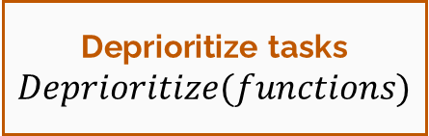
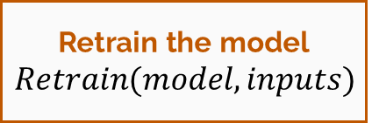
Guardrail Interface – Specifying Actions
Properties and Actions
Interface Grammar
〈Guardrail〉 ::= 〈Property〉 〈Action〉+
〈Property〉 ::= 〈Trigger〉+ 〈Rule〉+
〈Trigger〉 ::= TIMER | FUNCTION
〈Rule〉 ::= 〈Expression〉
〈Action〉 ::= REPORT | REPLACE | RETRAIN |
DEPRIORITIZE | <Expression>
Report to a log
$$Report(state,log)$$
Replace with a heuristic
$$Replace(model, baseline)$$
Retrain the model
$$Retrain(model,inputs)$$
Deprioritize tasks
$$Deprioritize(functions)$$
Notes:
For the action part of a guardrail, [RET] we currently provide a library for the four types of actions, we saw for LinnOS.
These actions can be specified via APIs that take certain arguments to implement desired corrective behavior.
In some cases, the sophistication of actions may be outside of the scope of just these four APIs. For such cases, we can let users provide expressions for the actions.
This narrow interface allows for easy compilation of guardrails into system artifacts that can be installed into the kernel; as opposed to using arbitrary user-defined callbacks.

Slide 19

Guardrail State Store
Rich properties and actions may require states, such as:
  States available in the learned policy,
  States tracked by the rule, e.g., counters, aggregates, etc.
  System metrics, e.g., CPU utilization.
Interface Grammar
〈Guardrail〉 ::= 〈Property〉 〈Action〉+
〈Property〉 ::= 〈Trigger〉+ 〈Rule〉+
〈Trigger〉 ::= TIMER | FUNCTION
〈Rule〉 ::= 〈Expression〉
〈Action〉 ::= REPORT | REPLACE | RETRAIN |
DEPRIORITIZE | <Expression>
A lightweight, global state store
SAVE(key, value)
LOAD(key)
Notes:
Rules and actions can also use interesting types of states.
[RET] For example, a guardrail rule may use a state available within a learned policy or it may use a state it is tracking such as counters or aggregates or it may use system metrics such as CPU Utilization. Similarly, an action may access/change a state used in the learned policy.
These states can be scattered across the kernel, within different locking primitives.
[RET] Instead of the developer having to wrangle with these different states, we want to make them accessible via a lightweight, global state store, with a simple API to save or load the state.
As a part of a long-term effort, we have started looking at some OS policies, and our initial thought is that this interface covers a lot of ground on the guardrails one needs for OS policies.

Slide 20
How Guardrails May Help in Practice
Target policy: I/O device latency predictor in LinnOS (OSDI’20)
Property:
  Rule: False submits should not be greater than 5%
  Trigger: Periodically, every 1 second
Action: Fallback to the default kernel policy.
I/O access
Revoke
Slow
Fast
SSD
False Submit: The model predicted an I/O access to be fast, but it ended up as a slow access.
Notes:
We implement a guardrail prototype for LinnOS, where a prediction model is used to predict whether an I/O access will be slow or fast.
Suppose we want to have the property that the false submit rate should be less than 5%.
[RET] Here the false submit rate means that the model predicted an access to be fast but it turned out to be slow. Say we want this to be checked every 1 second; and the action is to fallback to the default policy.
[RET] Under the proposed interface, here is how one could specify this guardrail. For example, the rule can be to check if the false_submit_rate is less than 5%.
[RET] Note that this false_submit_rate is a variable that can be accessed in the policy via the global state store.
[RET]
When we integrate this guardrail with LinnOS,

Slide 21
How Guardrails May Help in Practice
Target policy: I/O device latency predictor in LinnOS (OSDI’20)
Property:
  Rule: False submits should not be greater than 5%
  Trigger: Periodically, every 1 second
Action: Fallback to the default kernel policy.
I/O access
Revoke
Slow
Fast
SSD
False Submit: The model predicted an I/O access to be fast, but it ended up as a slow access.
guardrail low-false-submit {
trigger: { TIMER(1) },
rule: { false_submit_rate <= 0.05 },
action: { ml_enabled = false }
}
Notes:
We implement a guardrail prototype for LinnOS, where a prediction model is used to predict whether an I/O access will be slow or fast.
Suppose we want to have the property that the false submit rate should be less than 5%.
[RET] Here the false submit rate means that the model predicted an access to be fast but it turned out to be slow. Say we want this to be checked every 1 second; and the action is to fallback to the default policy.
[RET] Under the proposed interface, here is how one could specify this guardrail. For example, the rule can be to check if the false_submit_rate is less than 5%.
[RET] Note that this false_submit_rate is a variable that can be accessed in the policy via the global state store.
[RET]
When we integrate this guardrail with LinnOS,

Slide 22
How Guardrails May Help in Practice
Target policy: I/O device latency predictor in LinnOS (OSDI’20)
Property:
  Rule: False submits should not be greater than 5%
  Trigger: Periodically, every 1 second
Action: Fallback to the default kernel policy.
I/O access
Revoke
Slow
Fast
SSD
False Submit: The model predicted an I/O access to be fast, but it ended up as a slow access.
guardrail low-false-submit {
trigger: { TIMER(1) },
rule: { false_submit_rate <= 0.05 },
action: { ml_enabled = false }
}
Accessed via global state store
Notes:
We implement a guardrail prototype for LinnOS, where a prediction model is used to predict whether an I/O access will be slow or fast.
Suppose we want to have the property that the false submit rate should be less than 5%.
[RET] Here the false submit rate means that the model predicted an access to be fast but it turned out to be slow. Say we want this to be checked every 1 second; and the action is to fallback to the default policy.
[RET] Under the proposed interface, here is how one could specify this guardrail. For example, the rule can be to check if the false_submit_rate is less than 5%.
[RET] Note that this false_submit_rate is a variable that can be accessed in the policy via the global state store.
[RET]
When we integrate this guardrail with LinnOS,

Slide 23
How Guardrails May Help in Practice
I/O access
Revoke
guardrail low-false-submit {
trigger: { TIMER(1) },
rule: { false_submit_rate <= 0.05 },
action: { ml_enabled = false }
}
Slow
Fast
SSD
+
Changes inside LinnOS code
if LOAD("ml_enabled") {
// Use LinnOS predictions
}
...
// Update false submit rate
SAVE("false_submit_rate", false_submit_rate)
Notes:
[RET] we can use the states in the LinnOS code. For example, ml_enabled and false_submit_rates are states used to drive the desired behavior.
[RET] Overall, this is what an execution of a workload looks like when using LinnOS with and without guardrail. The Y axis shows the moving average of I/O latencies, so a lower curve is better.
[RET] we see that as soon as the false submit rate breaches the prescribed threshold, the guardrail switches to the default linux policy for the remaining run.
This shows that we can avoid ML when it is not performing up to par, and utilize its benefits in the cases where ML is beneficial; leading to an overall profitable use of Machine Learning in Operating Systems.

Slide 24
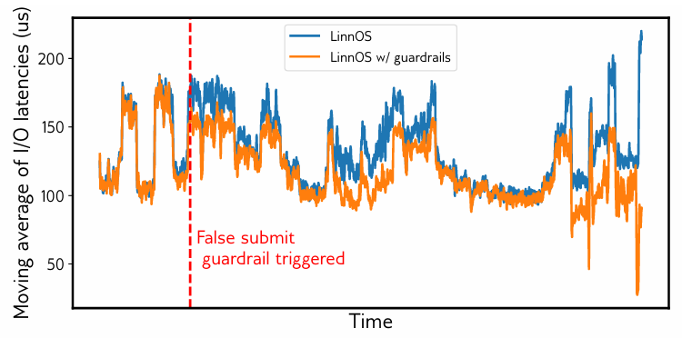
How Guardrails May Help in Practice
I/O access
Revoke
guardrail low-false-submit {
trigger: { TIMER(1) },
rule: { false_submit_rate <= 0.05 },
action: { ml_enabled = false }
}
Slow
Fast
SSD
+
Changes inside LinnOS code
if LOAD("ml_enabled") {
// Use LinnOS predictions
}
...
// Update false submit rate
SAVE("false_submit_rate", false_submit_rate)
Notes:
[RET] we can use the states in the LinnOS code. For example, ml_enabled and false_submit_rates are states used to drive the desired behavior.
[RET] Overall, this is what an execution of a workload looks like when using LinnOS with and without guardrail. The Y axis shows the moving average of I/O latencies, so a lower curve is better.
[RET] we see that as soon as the false submit rate breaches the prescribed threshold, the guardrail switches to the default linux policy for the remaining run.
This shows that we can avoid ML when it is not performing up to par, and utilize its benefits in the cases where ML is beneficial; leading to an overall profitable use of Machine Learning in Operating Systems.

Slide 25
How Guardrails May Help in Practice
I/O access
Revoke
guardrail low-false-submit {
trigger: { TIMER(1) },
rule: { false_submit_rate <= 0.05 },
action: { ml_enabled = false }
}
Default Linux Policy
Slow
Fast
SSD
+
Changes inside LinnOS code
if LOAD("ml_enabled") {
// Use LinnOS predictions
}
...
// Update false submit rate
SAVE("false_submit_rate", false_submit_rate)
Notes:
[RET] we can use the states in the LinnOS code. For example, ml_enabled and false_submit_rates are states used to drive the desired behavior.
[RET] Overall, this is what an execution of a workload looks like when using LinnOS with and without guardrail. The Y axis shows the moving average of I/O latencies, so a lower curve is better.
[RET] we see that as soon as the false submit rate breaches the prescribed threshold, the guardrail switches to the default linux policy for the remaining run.
This shows that we can avoid ML when it is not performing up to par, and utilize its benefits in the cases where ML is beneficial; leading to an overall profitable use of Machine Learning in Operating Systems.

Slide 26



Open Research Directions
Learned Policy
Evolve guardrails as properties or actions change.
Low-overhead property tracking, when using system-wide features
Learned Policy 1
Learned Policy 2
Seamless guardrail compilation for in-kernel enforcement.
Managing interference among guardrails monitoring different properties
...and many more
Notes:
Our proposal opens several research avenues to explore.
[RET] First, how to dynamically evolve guardrails for stricter/weaker property adherence depending on system state and workloads.
[RET] Second, how to enable low overhead tracking of properties especially when properties rely on system wide features or the proposed state store with user-defined states.
[RET] Third, how to automatically compile guardrails into artifacts that can run in the kernel, so that the OS policy developer does not have to reimplement major chunks of the guardrails.
[RET] Fourth, how to manage interference of different guardrails monitoring different properties.

Slide 27
Summary
We propose OS Guardrails—a framework that enables safe, effective, and high-impact use of learned policies.
Guardrails track adherence to a property and allow taking corrective actions when violated.
Preliminary experiments show promising results for the proposed interface and design.
Opens several avenues for research on enabling low-overhead and flexible guardrails in the OS.
Violation
Action
Thank You!
Notes:
I hope I was able to convince you all that to realize learned OS policies, guardrails are an important and necessary piece. And that with the right guardrails, one can exploit the full benefits of ML.

