Slide 1




Rethinking Tiered Storage:
Talk to File Systems, Not Device Drivers
Funded
by
Jiyuan Zhang
Jongyul Kim, Chloe Alverti, Peizhe Liu, Weiwei Jia, and Tianyin Xu
Notes:
Hi everyone, I am Jiyuan Zhang, a first year PhD student from UIUC. Today I will present our work, Rethinking Tiered Storage: Talk to File Systems, Not Device Drivers.
This is a collaborative work between University of Illinoi and University of Rhode Island.

Slide 2
Storage devices are diversifying
CXL
PM
SSD
HDD
Tape
Film
Notes:
So, in the last three decades, our storage solution is dominated by two types of devices, SSD and HDD. Both of them are block devices and shares similar semantics and file systems. Hence, our storage solution used to be homogeneous.

Slide 3
Storage devices are diversifying
🚀🚀🚀
🚀🚀
🚀
🐖
🪙
🐖🐖
🪙 🪙
🐖🐖🐖
🪙 🪙 🪙
CXL
PM
SSD
HDD
Tape
Film
Cache
Coherent
Memory
Semantic
Limited
Write Cycles
Prefer
Sequential
Slow
Seeking
Write
Once
Notes:
However, things have changed today. As new storage devices are developed, now our storage solution is diversifying, and it is expected to be more diverse in the future.
For example, on one extreme, we are now observing the raise of CXL-SSD, and on the other extreme, companies like GitHub are using films to backup data such as our git repositories.
[C]
These new devices leads to different performance and cost tradeoffs,
And they also shows totally different device characteristics, like the cache coherency of CXL and the write once property of films

Slide 4
New devices lead to heterogeneous configurations
We need to use the new devices
…
AND the old ones.
CXL
CXL
Optane
PM
SSD
SSD
SSD
HDD
HDD
Tape
Tape
Film
Latest
Features
Performance
Advantage
Data
Reliability
Backward
Compatibility
🚀🚀🚀
🚀🚀
🚀
🐖
🪙
🐖🐖
🪙 🪙
🐖🐖🐖
🪙 🪙 🪙
Cache
Coherent
Memory
Semantic
Limited
Write Cycles
Prefer
Sequential
Slow
Seeking
Write
Once
Notes:
Since we always want the best of both worlds, the diversity in storage devices naturally motivates heterogeneous storage device configurations.
[C]
On one hand, we want to enjoy the latest features and performance advantage brought by the new devices.
[C]
On the other hand, we also want the battle-tested data reliability and backward compatibility of the traditional devices.

Slide 5
New devices lead to heterogeneous configurations
PM
SSD
HDD
CXL
PM
SSD
Balanced Configuration
Performance Configuration
CXL
HDD
Tape
SSD
Tape
Film
Capacity Configuration
Archival Configuration
Notes:
Hence, we are now observing the raise of heterogeneous storage solutions.
However, to meet different types of demands, different scenarios may require different storage configurations that are heterogeneous in nature to accommodate their storage needs.
For example, for high-performance storage, we want to use CXL-SSD and Optane, but for archival ones, we use tapes and films.

Slide 6
New devices lead to heterogeneous configurations
Research Question:
How to build practical file system
for diverse storage configurations?
Notes:
So, naturally, the key research question for heterogeneous storage is: How to build practical file systems for diverse storage configurations.

Slide 7
Existing solutions are falling behind
PM
SSD
HDD
Notes:
Previously, there are efforts that explore this area. However, these existing solutions are falling behind.

Slide 8
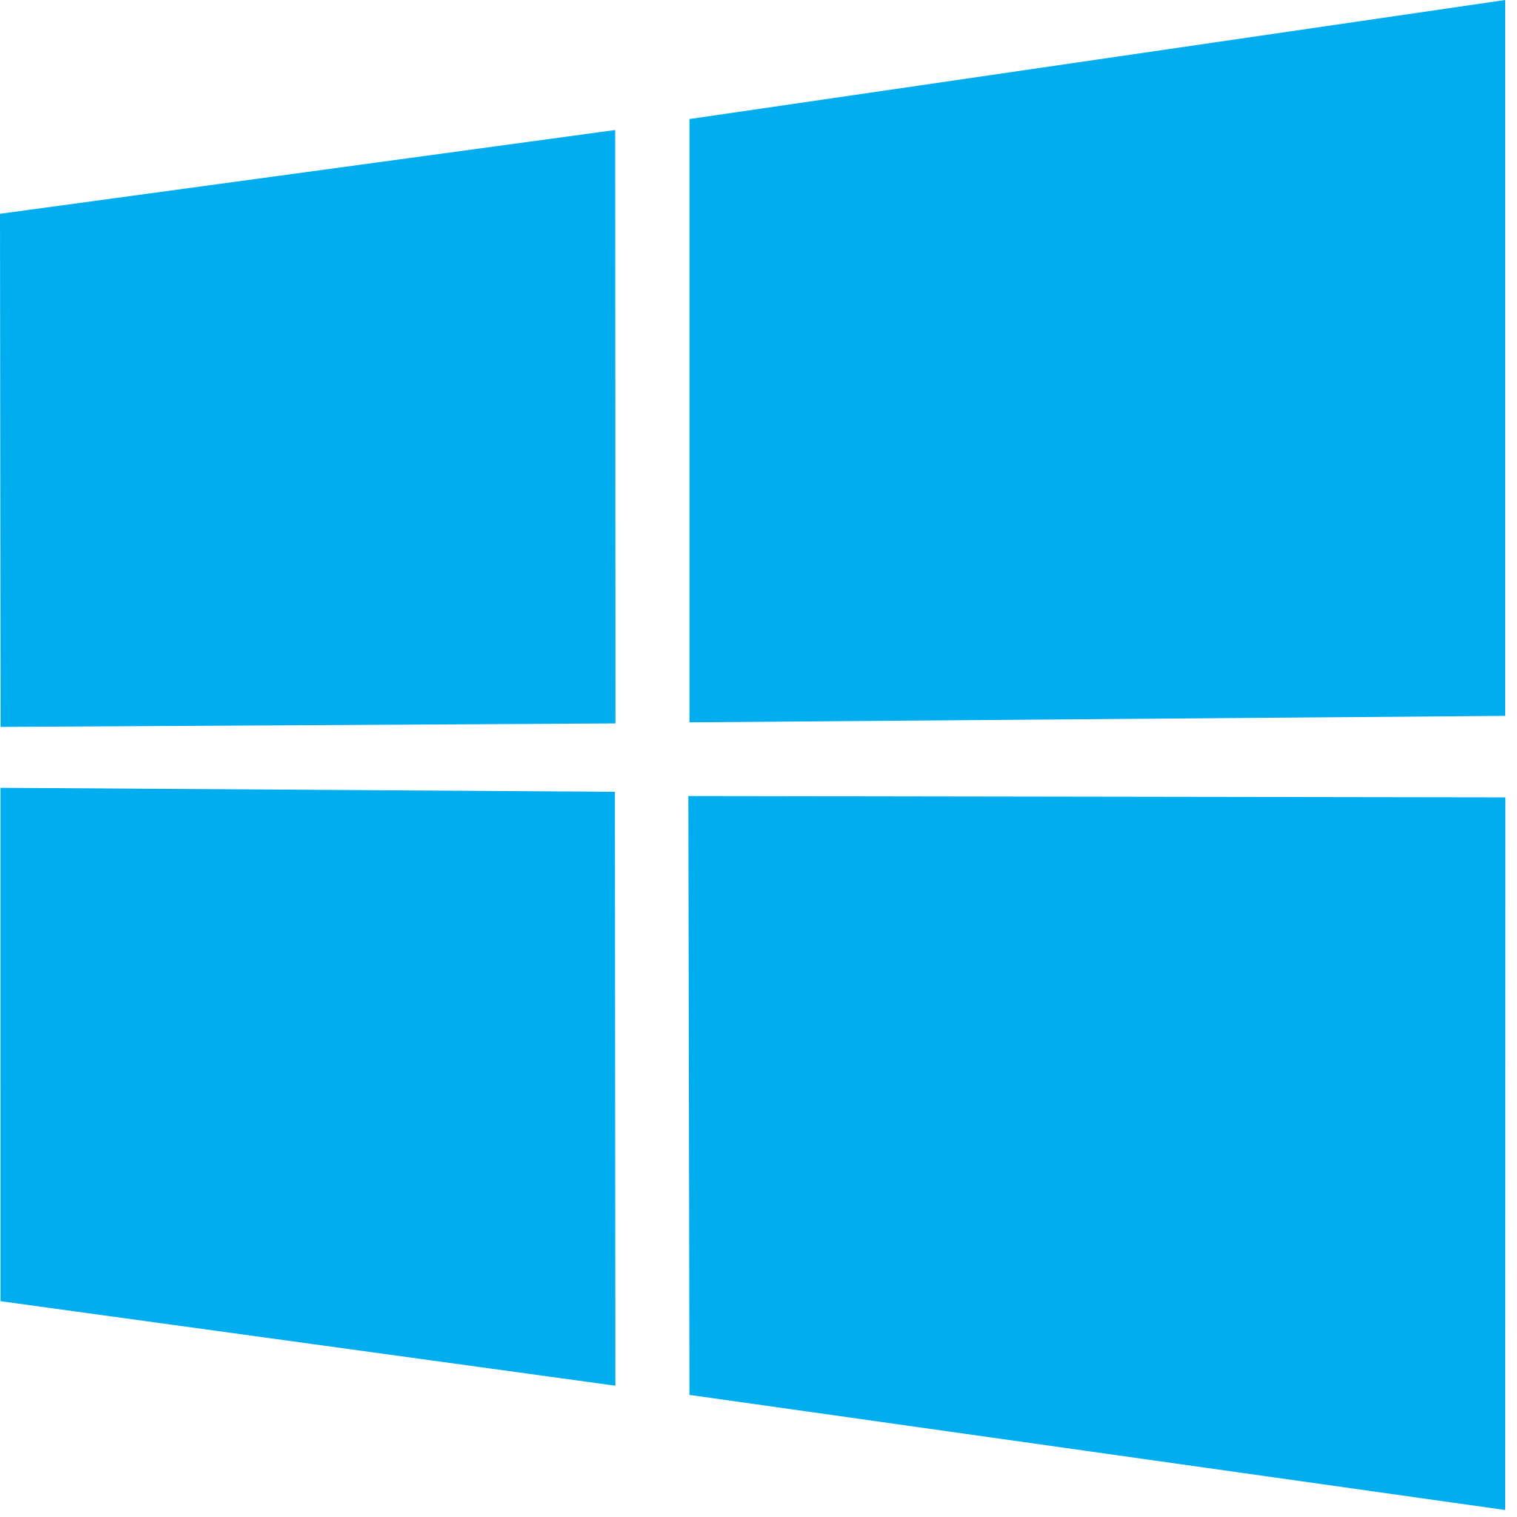
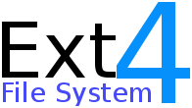
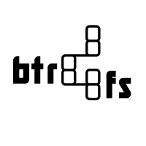
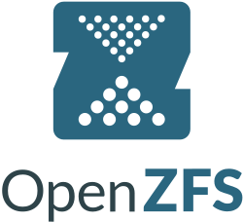
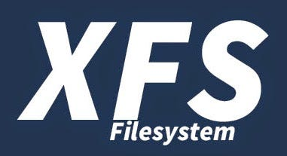
Existing solutions are falling behind
Linux VFS Infra
Monolithic
Tiered File System^{[a]}
PM
Driver
SSD
Driver
HDD
Driver
Need to
reinvent the wheel
PM
SSD
HDD
Tape
😵
Hard to extend
supported devices
We observe the imperfections in the state-of-the-art monolithic tiered file system Strata
Notes:
The problem there is that for these existing solutions, they tend to build the solution as a tightly coupled single package, which is a monolithic tiered file system, such as the latest state-of-the-art Strata.
However, such an approach has several points fall short.
[C]
First, we argue that the current practice of developing tiered file systems [p] cannot catch up with the progress of device-specific file systems.
This is because the developers have to address multiple device types simultaneously, rather than specializing.
[C]
Also, it is very hard for a monolithic tiered file system to be extended for new devices.
For example, to support tape as a new device, the file system needs to be rewritten to overhaul its tiering policy, to hook up the device driver, and also to address the characteristics of the new devices and its interaction with other devices.

Slide 9
… and it introduces practical shortcomings
Old
System
Linux VFS Infra
New
Design
Monolithic
Tiered File System
📂
📂
📂
📂
📂
⛔
Lack of metadata
compatibility
PM
Driver
PM
Driver
SSD
Driver
SSD
Driver
HDD
Driver
HDD
Driver
Need to
reinvent the wheel
PM
PM
SSD
SSD
HDD
HDD
Tape
😵
Hard to extend
supported devices
Notes:
Sadly, even if someone has paid the effort, the old way still introduces other practical shortcomings.
[C]
First, because we are building a new file system that are fundamentally different due to its multi-device nature, the new one would lack metadata compatibility with the user's old systems. So, the users have to perform a costly and risky metadata migration or even full volume migration to adopt the new design.

Slide 10
… and it introduces practical shortcomings
Old
System
Linux VFS Infra
Linux VFS Infra
Mux
Monolithic
Tiered File System
📂
📂
📂
⛔
Lack of metadata
compatibility
PM
Driver
PM
Driver
SSD
Driver
SSD
Driver
HDD
Driver
HDD
Driver
Need to
reinvent the wheel
PM
PM
SSD
SSD
HDD
HDD
Tape
😵
🚫
Hard to extend
supported devices
Poor reusability
for other systems
Notes:
And also, the file system built would lack of usability for other systems, because it is designed to support the one configuration instead of being a generic solution.
Hence, people have to build their own file systems and the product will lock the user into their existing configuration and prevents further evolution.
[C]
In summary, with all these shortcomings, we need to rethink how we should build a tiered file system, and here are our new ways.
[NEXT]
In our paper, we propose Mux, which is a new way of designing tiered file system.

Slide 11
Mux: Talk to file systems, not device drivers
Linux VFS Infra
Linux VFS Infra
Monolithic
Tiered File System
Mux
PM
Driver
SSD
Driver
HDD
Driver
PM
Driver
SSD
Driver
HDD
Driver
PM
SSD
HDD
PM
SSD
HDD
Notes:
In our paper, we propose Mux, which is a new way of designing tiered file system.

Slide 12
Mux: Talk to file systems, not device drivers
Linux VFS Infra
Linux VFS Infra
Mux
Monolithic
Tiered File System
PM
File Sys.
SSD
File Sys.
HDD
File Sys.
PM
Driver
SSD
Driver
HDD
Driver
PM Drv.
SSD Drv.
HDD Drv.
PM
SSD
HDD
PM
SSD
HDD
Notes:
The key idea of Mux to introduce a dedicated component for tiering over single-device file systems, rather than directly work on device drivers.
With this design, Mux can enhance tiering solutions and solve the previous shortcomings.

Slide 13

Our Contributions
Linux VFS Infra
Mux can directly use
latest file systems / devices
Mux
Mux decouples
tiering from device mgmt.
Monolithic
Tiered File System
PM
File Sys.
SSD
File Sys.
HDD
File Sys.
Tape
File Sys.
PM
Driver
SSD
Driver
HDD
Driver
PM Drv.
SSD Drv.
HDD Drv.
Tape Drv.
✅ Flexibility
✅ Modularity
✅ Compatibility
PM
SSD
HDD
PM
SSD
HDD
Tape
📂
📂
📂
Mux supports tiering
over existing storage in production
Notes:
Mux treats extensibility as a first-class principle.
It decouples tiering from device management by leveraging the well-defined file system abstraction, such as the Linux VFS interface and the POSIX semantic, so that the user can freely swap in or out file systems.
[C]
Mux can also incorporate latest file systems and devices directly due to its modular design, so that people do not need to reinvent the wheel [p] and can enjoy the latest advancement in file system development immediately.
[C]
And finally, because Mux works over existing file systems and adds tiering outside the blackbox, the metadata scheme of existing data is not changed. Also, when the data is migrated, it could be stored on another battle-tested file system. Thus, Mux reduces the risk of adopting tiered storage.

Slide 14
Dispatch user requests, not block I/Os
User Request to a File
VFS
Mux
Mux splits VFS reqs. by device
Block
Lookup Table
FS A
FS B
Handle Requests
Handle Requests
Notes:
So, let's zoom in and see how Mux is designed.
[C]
For user requests to a file, the principle of Mux is to dispatch user requests, not block I/Os. Here, we use the orange bar to represent a user request that attempts to access a part of a file.
[C]
When handling user requests, Mux will look up a block lookup table to decide which part of the user request belongs to which file system.
[C]
And then it will split the VFS request by devices and dispatch the corresponding requests to the respective file systems, [p] so the single-device file system can handle tiered requests while still maintaining their encapsulation, leaving space for internal optimization such as caching, reordering, or batching.

Slide 15
Track metadata location, not its content
User Request to Metadata
Modif. Time
Disk Usage
VFS
Mux
Modif. Time
Mux collects metadata from FSes
Disk Usage
Disk Usage
Metadata
Affinity Table
FS A
FS B
Modif. Time
(Outdated)
Disk Usage
on FS A
Modif. Time
(Latest)
Disk Usage
on FS B
Notes:
For metadata, Mux similarly tracked metadata location rather than its content. Here, the user want to know the last modification time and disk usage of a given file.
[C]
We observe that for each file system that Mux performs tiering on, one or some of them must contain the right version of metadata because Mux reflects all user operations to them.
For example, the file system handled the last change will have the right modification time, and the disk usage of a file is the sum of all file systems’.
[C]
So, Mux will look up the metadata affinity table to learn where to obtain the right metadata and dispatch the metadata queries to the underlying file systems.
Then, Mux will summarize the result and report to the user.

Slide 16
Migrate with versioning, not locking
VFS
Mux
File systems’ lock scope
only applies to themselves internally
Mux cannot utilize file system locks
due to potential deadlock with user locks
FS A
FS B
Lock Scope
Lock Scope
Locked by Mux
Wait B
Wait A
Locked by User
Notes:
A challenge of Mux is to handle migration across file systems, as the underlying file systems has no awareness of other file systems.
[C]
However, a key issue here is the file systems lock scope only apply to themselves.
[C]
A trivial attempt is to let Mux locks each member file systems before migration of data blocks.
[C]
However, such way is untenable, as users may also use POSIX calls like F-lock or FCNTL to lock a part or a whole file.
This creates chances for interference and even deadlock between user application and Mux. Hence, we need to think another way for migration.

Slide 17
Migrate with versioning, not locking
VFS
Mux
Mux uses optimistic concurrency control
for both correctness and performance
FS A
FS B
Version Counter
Version Counter
📂
1
2
3
5
6
7
Notes:
Mux uses a versioning design called optimistic concurrency control instead of implementing another locking for both correctness and performance.
[C]
This scheme maintains an increment-only version counter for each migratable block within a file.
[C]
During migration, the counter is bumped twice, once when starting the migration and once when finishing the migration.

Slide 18
Migrate with versioning, not locking
VFS
Mux
Mux uses optimistic concurrency control
for both correctness and performance
User Request
3
1
FS A
FS B
Version Counter
Version Counter
📂
1
2
3
5
6
7
Notes:
When Mux handles a user request, it snapshots the version number and later compare it with the current value.
[C]
If the request run parallelly with a migration request, the change in version number can be detected and the user requests can be retried after the migration is done.

Slide 19
Migrate with versioning, not locking
VFS
Mux
Mux uses optimistic concurrency control
for both correctness and performance
User Request
User Request
3
6
1
6
FS A
FS B
Version Counter
Version Counter
📂
1
2
5
6
Notes:
Also, even if the request finishes during a migration, as the version number has different parity during and after a migration, the conflict can still be detected.

Slide 20
Cache on DAX devices, not only DRAM
DRAM Memory
📓
📓
📓
📓
VFS
Mux
Mux can support page cache
with both DRAM and DAX pages
DRAM may be scarce and
competed among file systems
FS A
FS B
DAX Mem Pool
😵
😵
📓
📓
📓
📓
DAX Enabled
Use Page Cache
Notes:
Mux also supports caching on DAX device like some existing tiered file systems.
[C]
Usually, single-device file system only pulls cache pages from DRAM. However, this may be insufficient due to inter-file system contention over DRAM resources.
[C]
To address this, Mux exploits the capability of DAX-enabled file systems by building DAX memory pools on these file systems such as NOVA.
[C]
Mux then proxies page cache allocation requests and pulls pages from both the DAX and DRAM memory pools and provide them to file systems that want cache pages.
In this way, Mux mitigates cache contention and maximizes resource utilization.

Slide 21

Evaluating a prototype of Mux
Extensibility = 5 LoC / added device
Env = Ubuntu 20.04 on Linux 5.15
Tool = microbench from Strata
PM = Intel Optane PM 200
SSD = Intel Optane SSD DC P4800X
HDD = Seagate Exos X18
Linux VFS Infra
Mux
PM
File Sys.
SSD
File Sys.
HDD
File Sys.
PM Drv.
SSD Drv.
HDD Drv.
PM
SSD
HDD
Notes:
We now evaluate the prototype of Mux. The prototype is built by two gradates students within a month, as the design of Mux enables us to reuse most parts of existing file systems. Hence, we only need to focus on implementing the control plane that handles the tiering logic.
[C]
To evaluate the extensibility, we asked a new master student to add supports to different devices to the prototype.
Our prototype only requires to add five lines of code per new device, which describes the file system’s mount option and property. Such descriptions can be isolated into configuration files later.
[C]
We evaluate Mux on real machine that runs stock Ubuntu twenty-oh-four. We use the microbenchmark from Strata for our tests, which is also the state-of-the-art that we will compare to.
[C]
We run the tests on a tiered storage composed of Optane, SSD, and HDD.
[C]
For the tests, our prototype uses NOVA, XFS, and EXT-four to drive the three devices respectively.

Slide 22
Mux brings more tiering possibilities
Target
Target
PM
SSD
HDD
PM
SSD
HDD
PM
375
208
PM
970
216
SSD
N/S
N/S
SSD
1185
211
Source
Source
HDD
N/S
N/S
HDD
244
221
Strata
Mux
Mux supports all
migration directions
Mux enables 2.59x faster
migration via FS optimizations
Unit: MB/s
N/S: Not Supported
Notes:
Mux brings more tiering possibilities
[C]
Here we show the performance metrics of Strata, which is the research artifact file system of the latest state-of-the-art in this area.
[C]
In the matrix, each row describes a source device, and each column is for a different target device. To read the matrix, one can use the migration source and target device to locate a cell.
[C]
For example, the migration performance from persistent memory to SSD is three hundred and seventy-five megabyte per second.
[C]
And similarly, here is the matrix for our prototype Mux.
[C]
The first thing to observe here is that Mux supports all migration directions while Strata does not.
This is because for Strata, creating a new migration directions requires manually matching the thread model, block size, et cetera for the pair of devices.
However, as Mux utilizes file system abstractions, all migration directions can be automatically supported.
[C]
On the other hand, Mux enables two-point-five-nine times faster migration by leveraging file system optimizations.
Note that it is Mux’s contribution to utilize the optimization of matured file system. No previous work is capable of doing so.

Slide 23
Mux makes high-performance achievable
Strata
600
Mux
400
Throughput (MB/s)
200
0
PM
SSD
HDD
Mux shows 1.46x higher
throughput for device I/O
Mux adds a worst-case read
latency overhead of 6.6% to 87.3%
compared to non-tiered FSes
Mux adds a worst-case write
throughput overhead of 1.6% to 3.5%
compared to non-tiered FSes
Notes:
Mux also makes high-performance tiered file system achievable. Here we compare the I/O throughput to different devices for Strata and Mux.
[C]
On X-axis, we show different devices destinations of I/O requests.
[C]
On Y-axis, we show the throughput number to the device.
[C]
Here is the result for Strata.
[C]
And here is the result for our prototype.
[C]
So, Mux shows one-point-four-six times higher throughput for device I/O because of its ability to reuse existing optimizations.
[C]
We also measured the overhead of Mux compared to the underlying non-tiered file systems.
Mux adds a worst-case read latency overhead of six to eighty-seven percent. This is because Mux maintains extra tiered metadata and functions like an extra file system over existing ones.
[C]
However, Mux only adds one-point-six to three-point-five percent of write throughput overhead. This is because Mux only orchestrates user requests, and it will not cause write amplification.

Slide 24
Future work: Mux can be further improved
Metadata could be better handled to reduce overhead, e.g., read latency.
Crash consistency can be enhanced beyond the lowest of all member file systems.
Feature imparity among file systems could be preserved for better compatibility.
Notes:
Mux can be further improved from the current research prototype.
First, metadata could be better handled to reduce the overhead of Mux, especially in terms of read latency.
[C]
And also, the crash consistency is currently set as the lowest of all member file systems. However, in the future, we can explore how to improve this consistency.
[C]
We also noticed that modern file systems tend to provide features that are beyond what POSIX requires. So, it would be an interesting topic to research how to preserve the feature imparity among file systems for better usability.

Slide 25
Future work: Mux enables new storage research
Scheduling of file I/O could now be done at VFS level with Mux, rather than block level.
Configuration of file systems for a given workload or a given set of storage devices can now be studied with Mux.
Distributed Mux can be designed to perform tiering among an array of machines over network.
Notes:
On the other hand, Mux can also enable new storage research.
For example, scheduling for file I/O could be now done at VFS level easily with Mux, rather than modifying the block scheduler of Linux.
This could potentially provide researchers with more contextual information to leverage on and also to simplify their design.
[C]
The configuration of different file systems for a given workload or a given set of storage device can now be studied.
Mux provides an abstraction over different types of devices, so they can be swapped easily, and this type of configuration studies could be carried out easier.
[C]
And finally, Mux can be designed to perform tiering among an array of machines over network, so distributed Mux is also a potential direction.

Slide 26
Conclusion
Rethinking Tiered Storage: Talk to File Systems, Not Device Drivers
Mux is a new tiered file system that accesses devices through file systems, rather than device drivers.
Extensibility as a first-class principle to
decouple tiering from device mgmt.
1.46x higher throughput for device I/O;
2.59x faster data migration over Strata.
Linux VFS Infra
Mux
PM
File Sys.
SSD
File Sys.
HDD
File Sys.
PM Drv.
SSD Drv.
HDD Drv.
PM
SSD
HDD
Notes:
In conclusion, our work Rethinking Tiered Storage: Talk to File Systems, Not Device Drivers outlines a new path towards tiered storage.
[C]
In this work, we proposed a new way to design tiered file system called Mux. It accesses devices through file systems rather than their device drivers.
[C]
Mux treats accessibility as a first-class principle to decoupling tiering from device management.
[C]
It achieves better performance through its unique ability to leverage matured file system optimizations, and it also provides a change to let users to freely choose their file systems in heterogeneous storage scenarios.
Thank you for listening. I’m happy to take questions now.

